Slide 1
Proteomics Update
Main Agenda:
Normalization Methods, Robustness Test
11/17/2023

Slide 2
Overview
1.1. log(Raw Ratio)
1.2. Few Thoughts About Robustness Testing
1.3. log(Raw Ratio) w/ ComBat
2.1. Z-score → log(Rank Ratio)
2.2. Z-score → log(Rank Ratio) w/ ComBat
3.1. Z-Score → Rank Difference
3.2. Z-Score → Rank Difference w/ ComBat
4. Summary Stats / Top Pathways / Insights?
Spoiler: Not the best results…

Slide 3
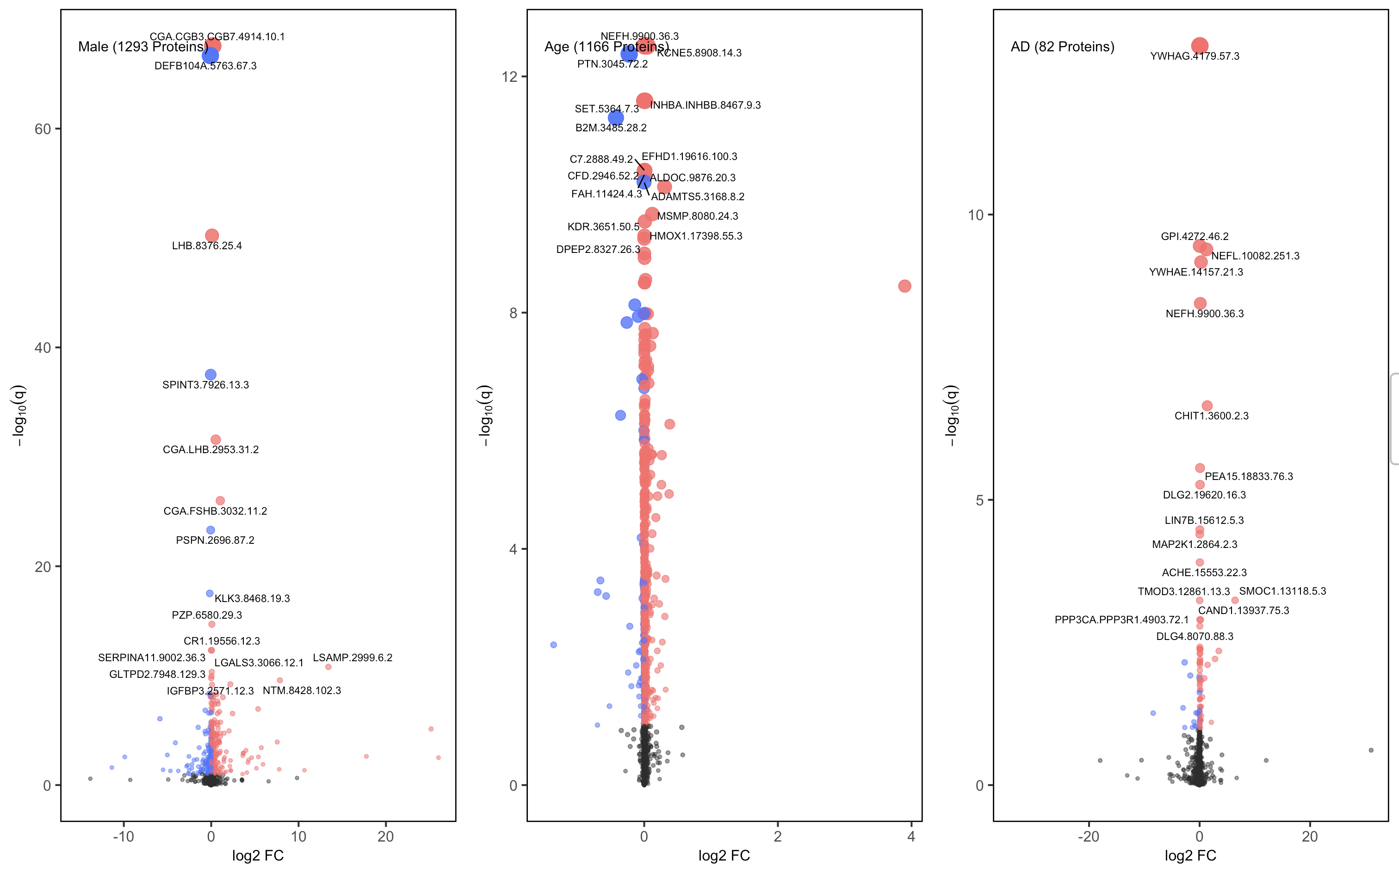
1. Raw Ratio
Variables: Sex, Age, Drawdate diff, Diagnosis, Storage days, Batch effect

Slide 4
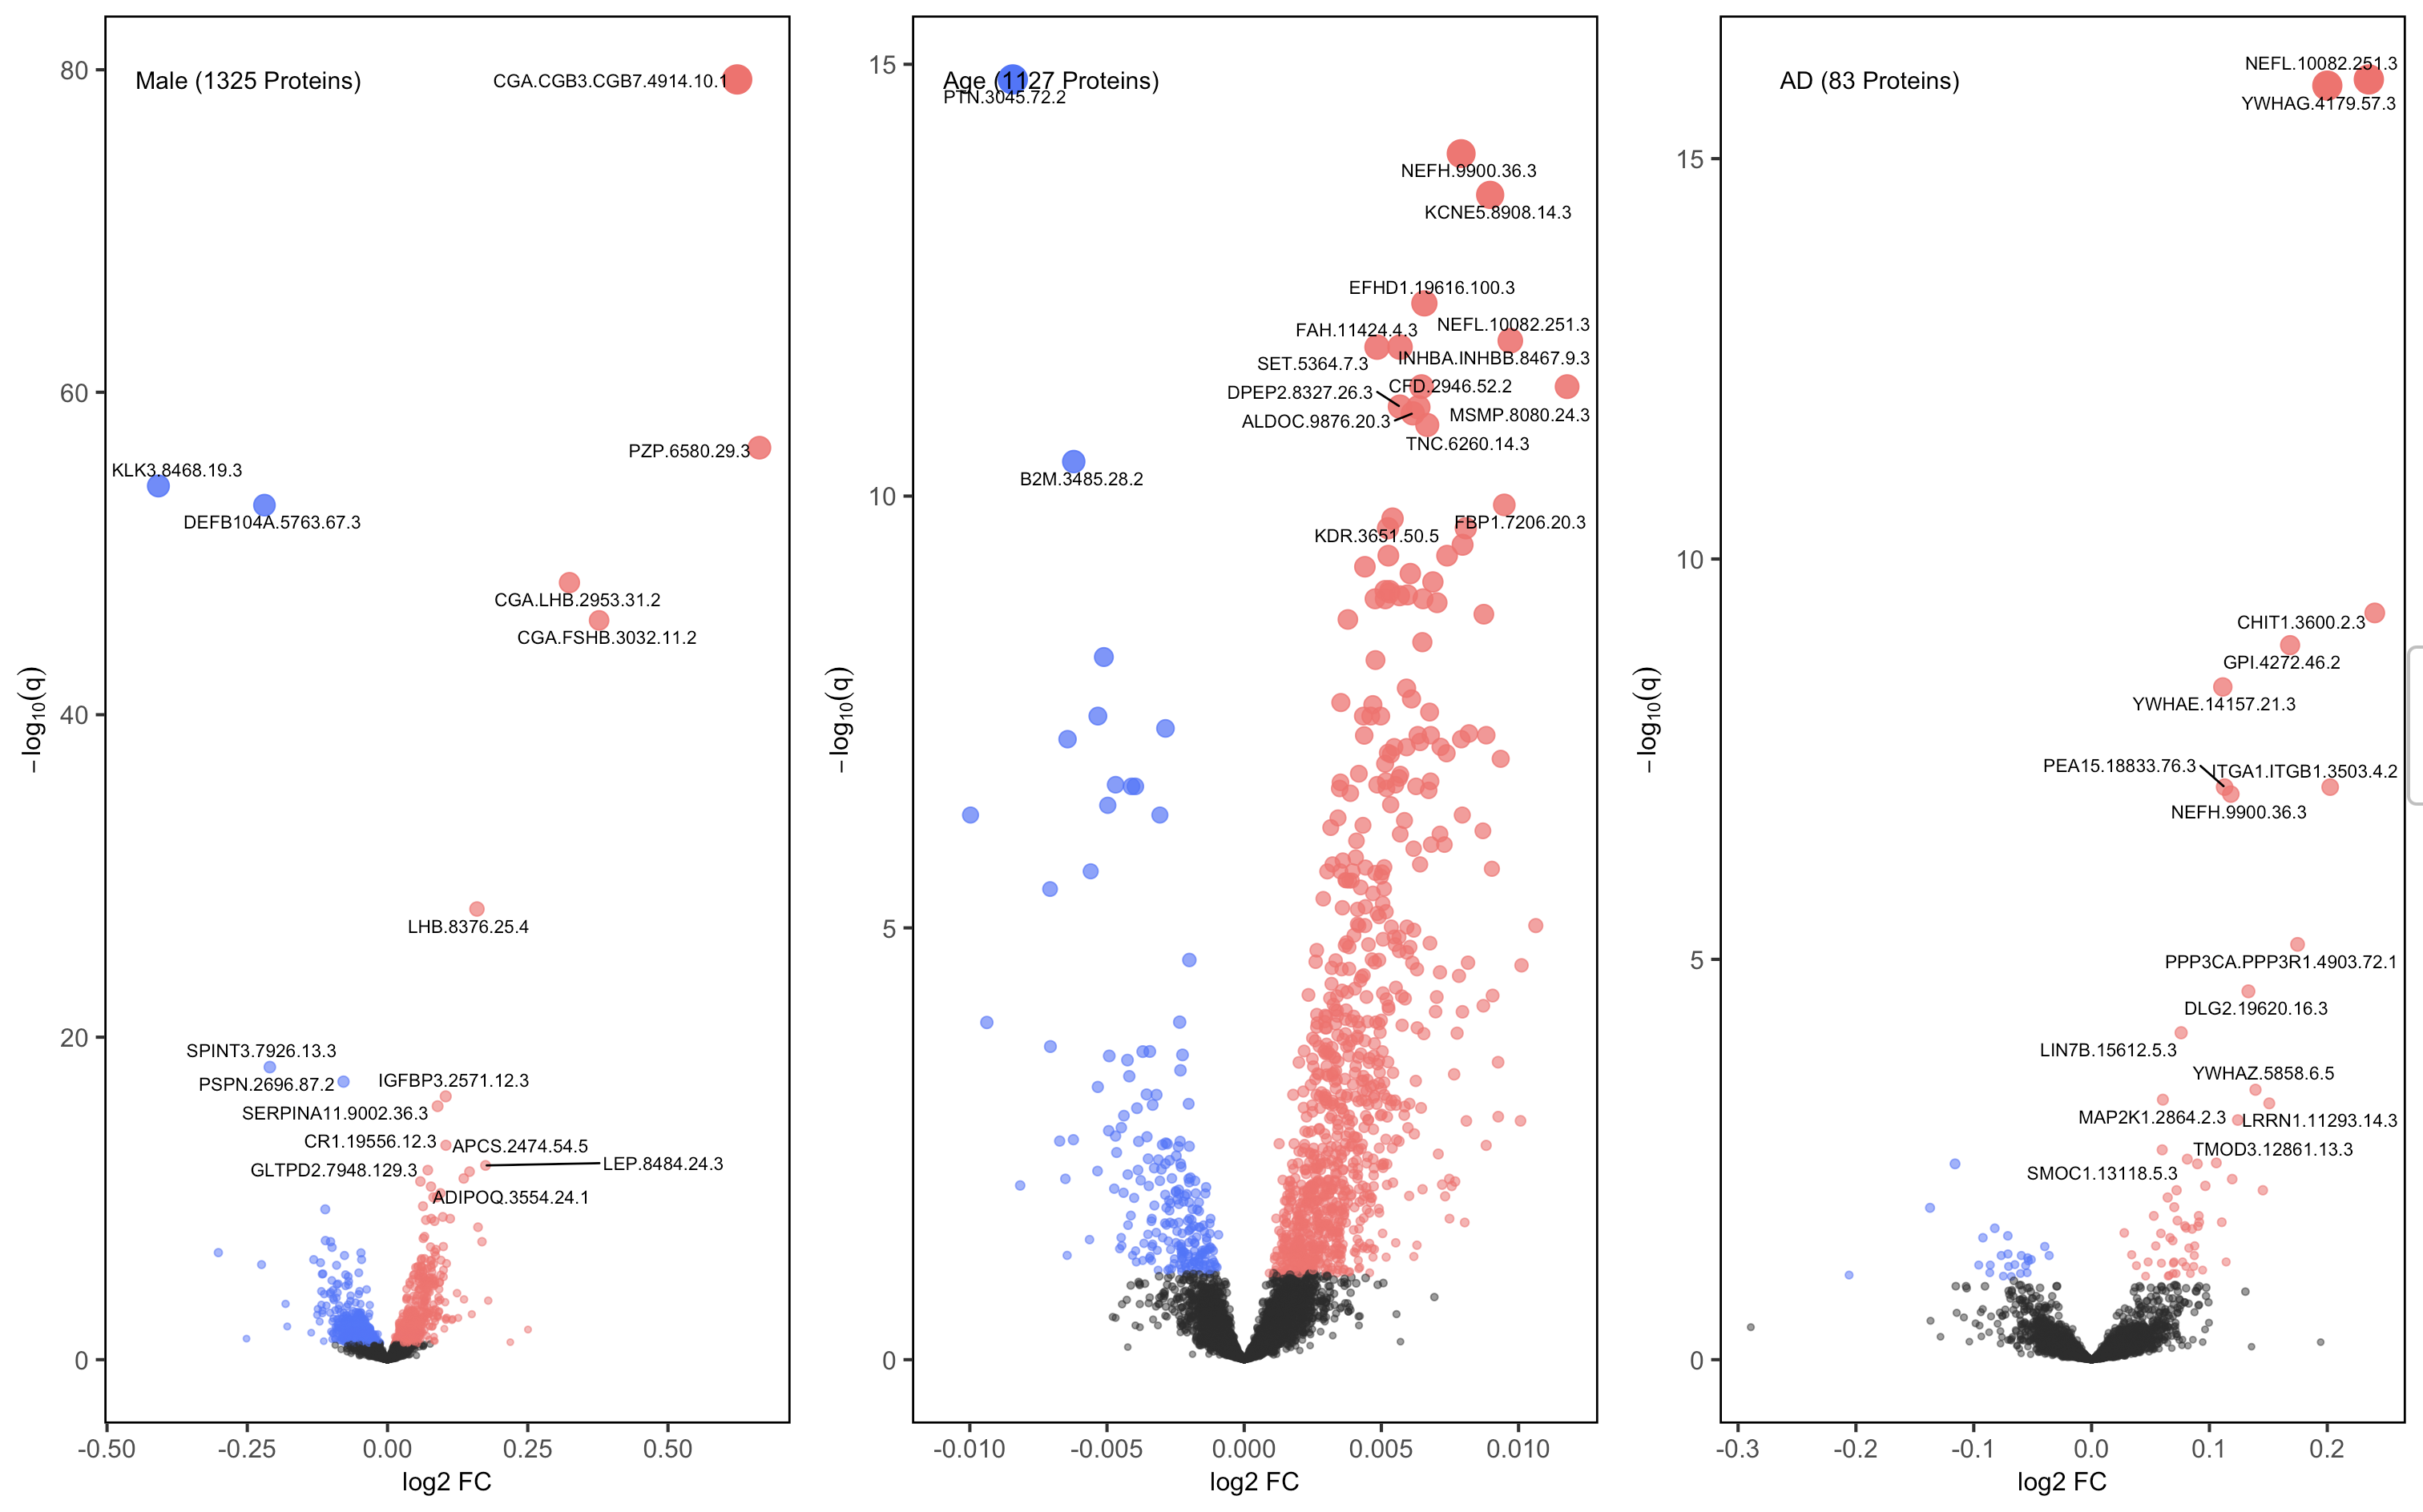
1. Log Raw Ratio
Variables: Sex, Age, Drawdate diff, Diagnosis, Storage days, Batch effect

Slide 5
1. Log Raw Ratio
Note that log(CSF / Plasma) is different from log(CSF) / log(Plasma),
and in this case, the logarithm was applied to just make the fold changes more pronounced
Variables: Sex, Age, Drawdate diff, Diagnosis, Storage days, Batch effect

Slide 6
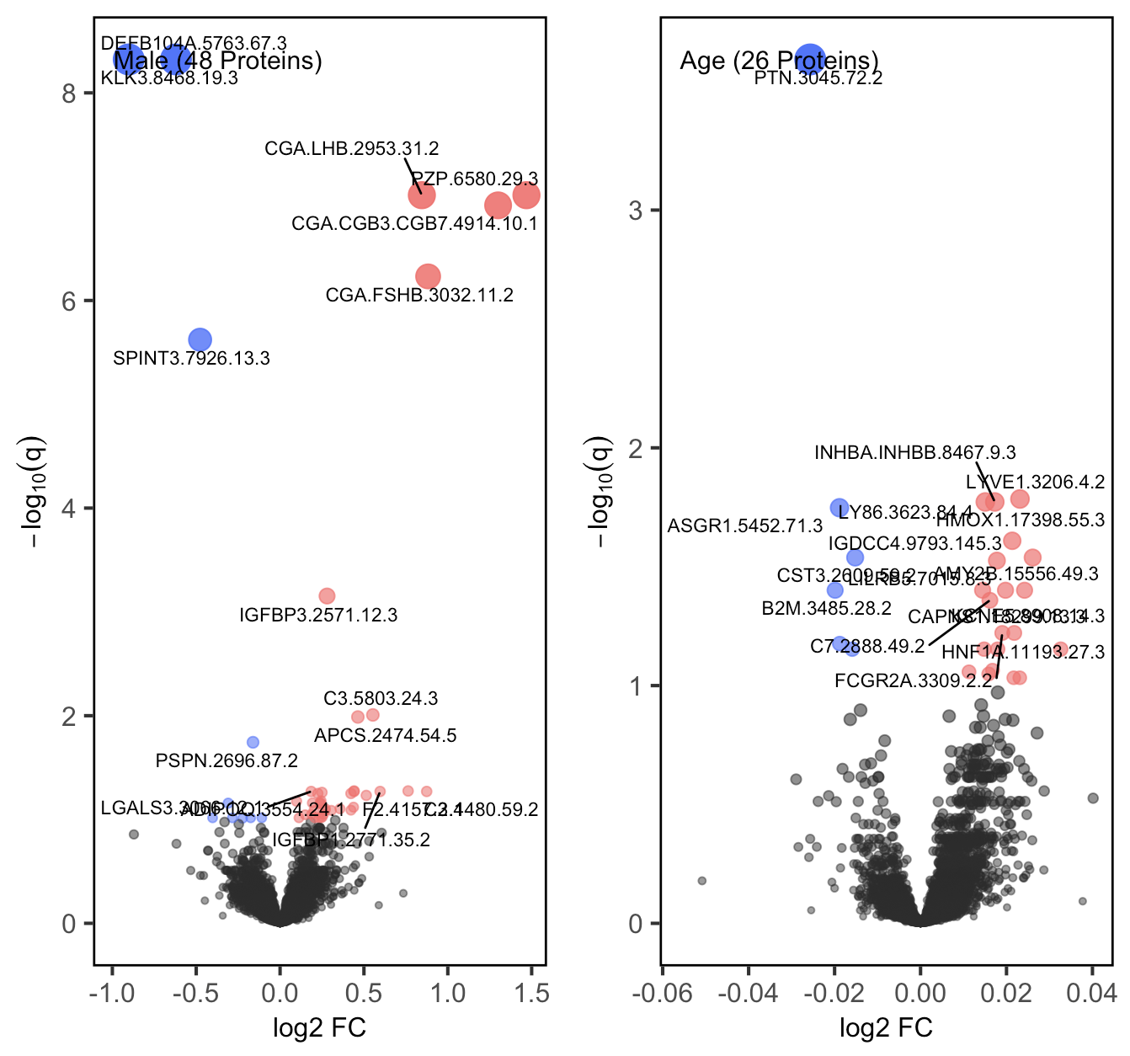
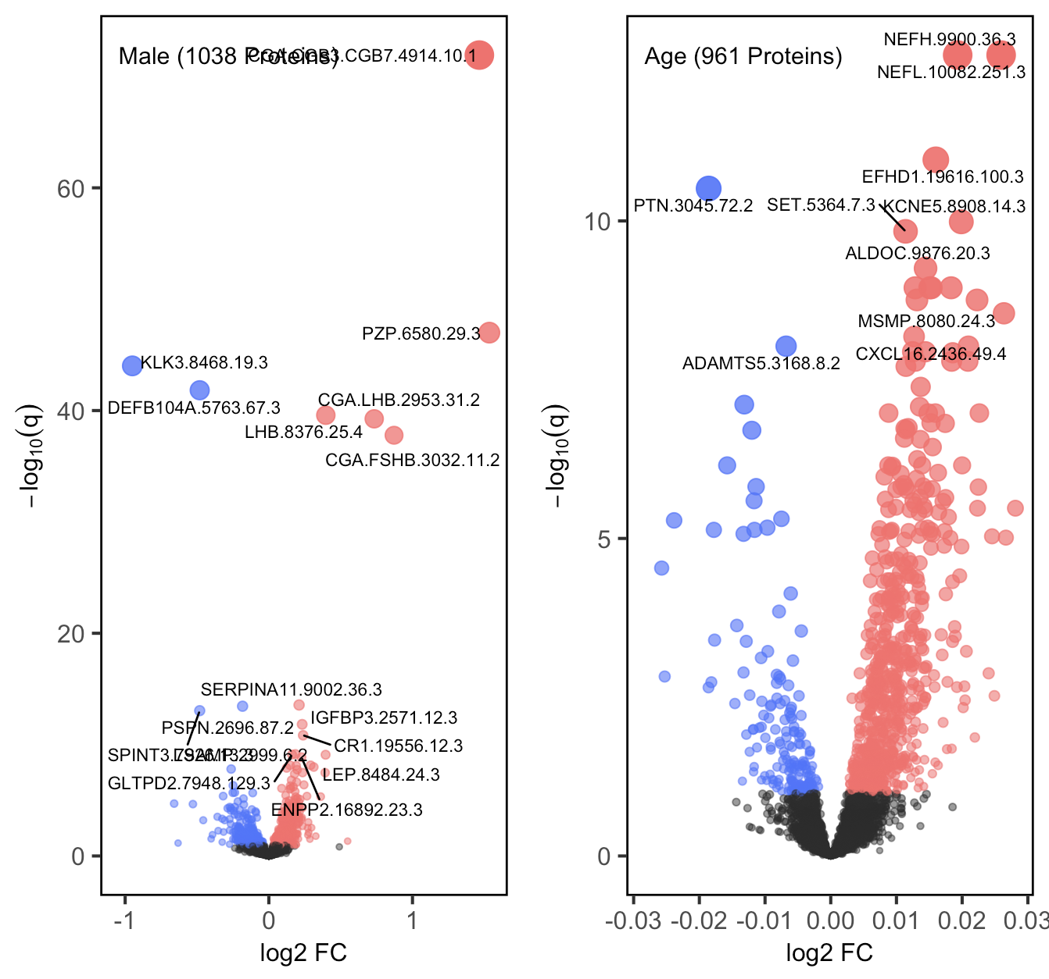
1. Log Raw Ratio: Stratified by Diagnosis
AD Group
CO Group
Variables: Sex, Age, Drawdate diff, Storage days, Batch effect

Slide 7
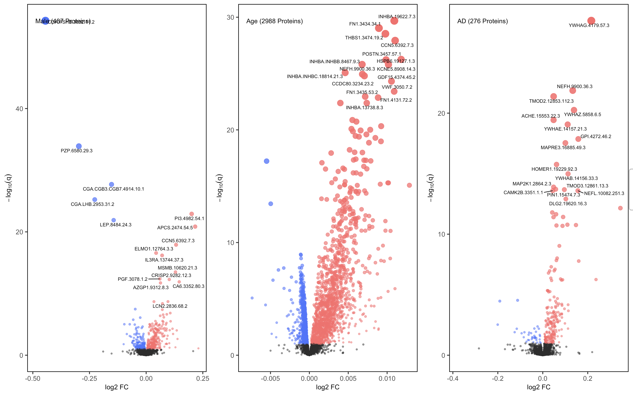
1. Log Raw Ratio: Sanity Check using Log Raw CSF
Variables: Sex, Age, Drawdate diff, Diagnosis, Storage days, Batch effect

Slide 8
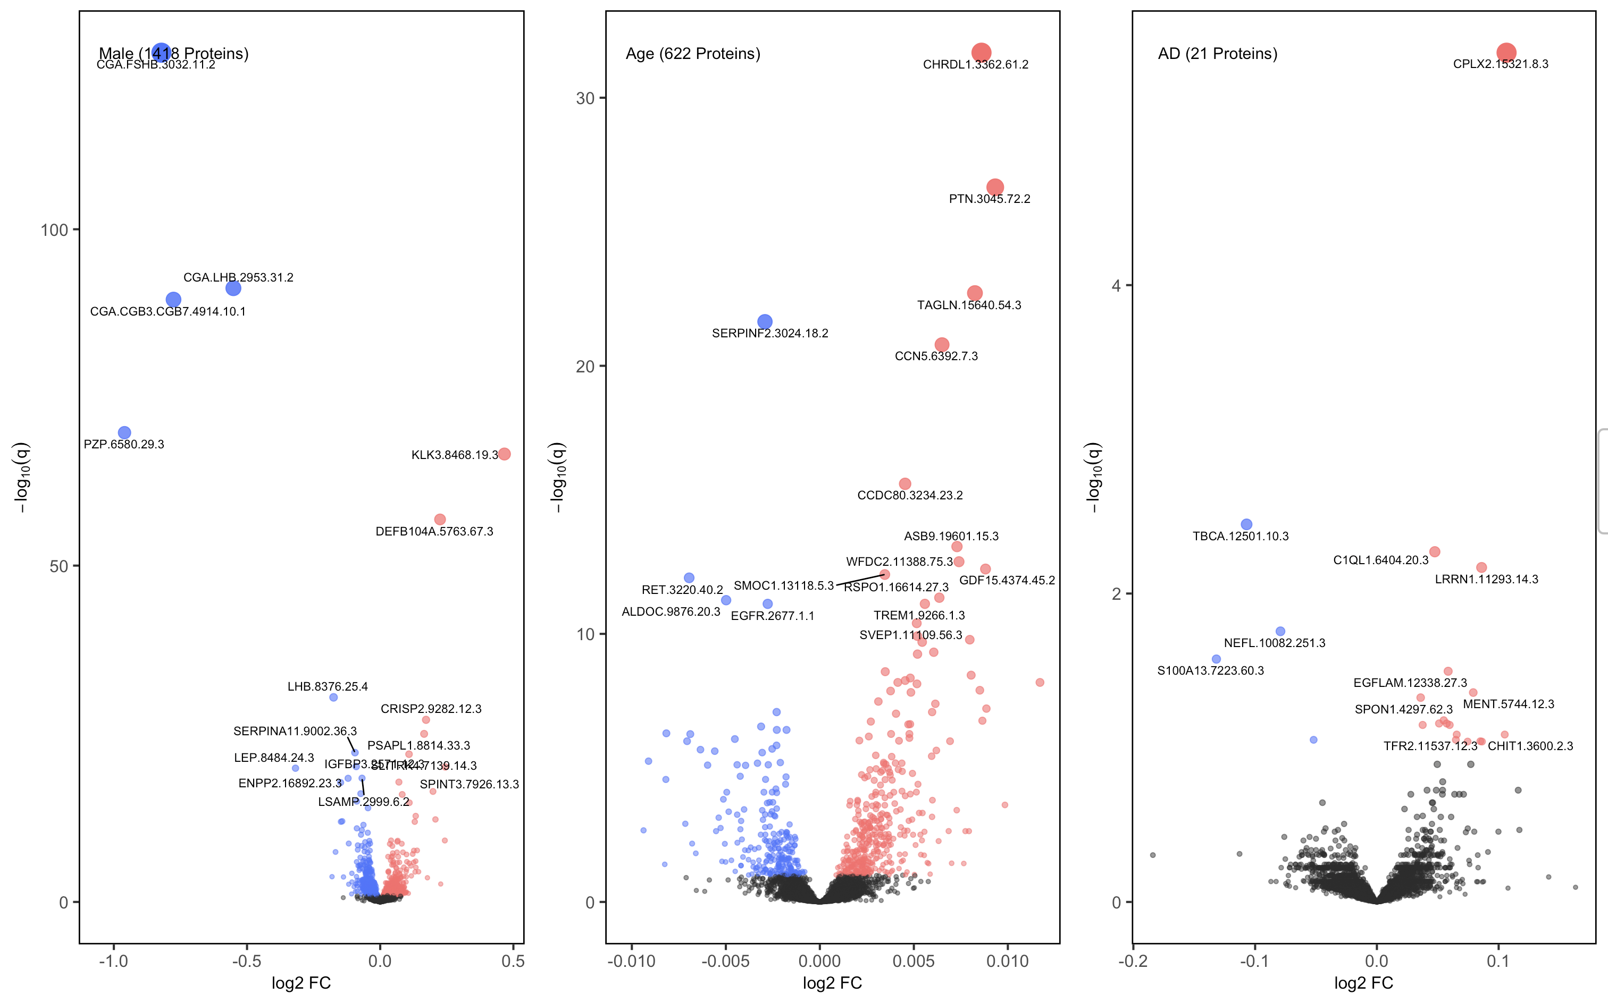
1. Log Raw Ratio: Sanity Check using Log Raw Plasma
Variables: Sex, Age, Drawdate diff, Diagnosis, Storage days, Batch effect

Slide 9
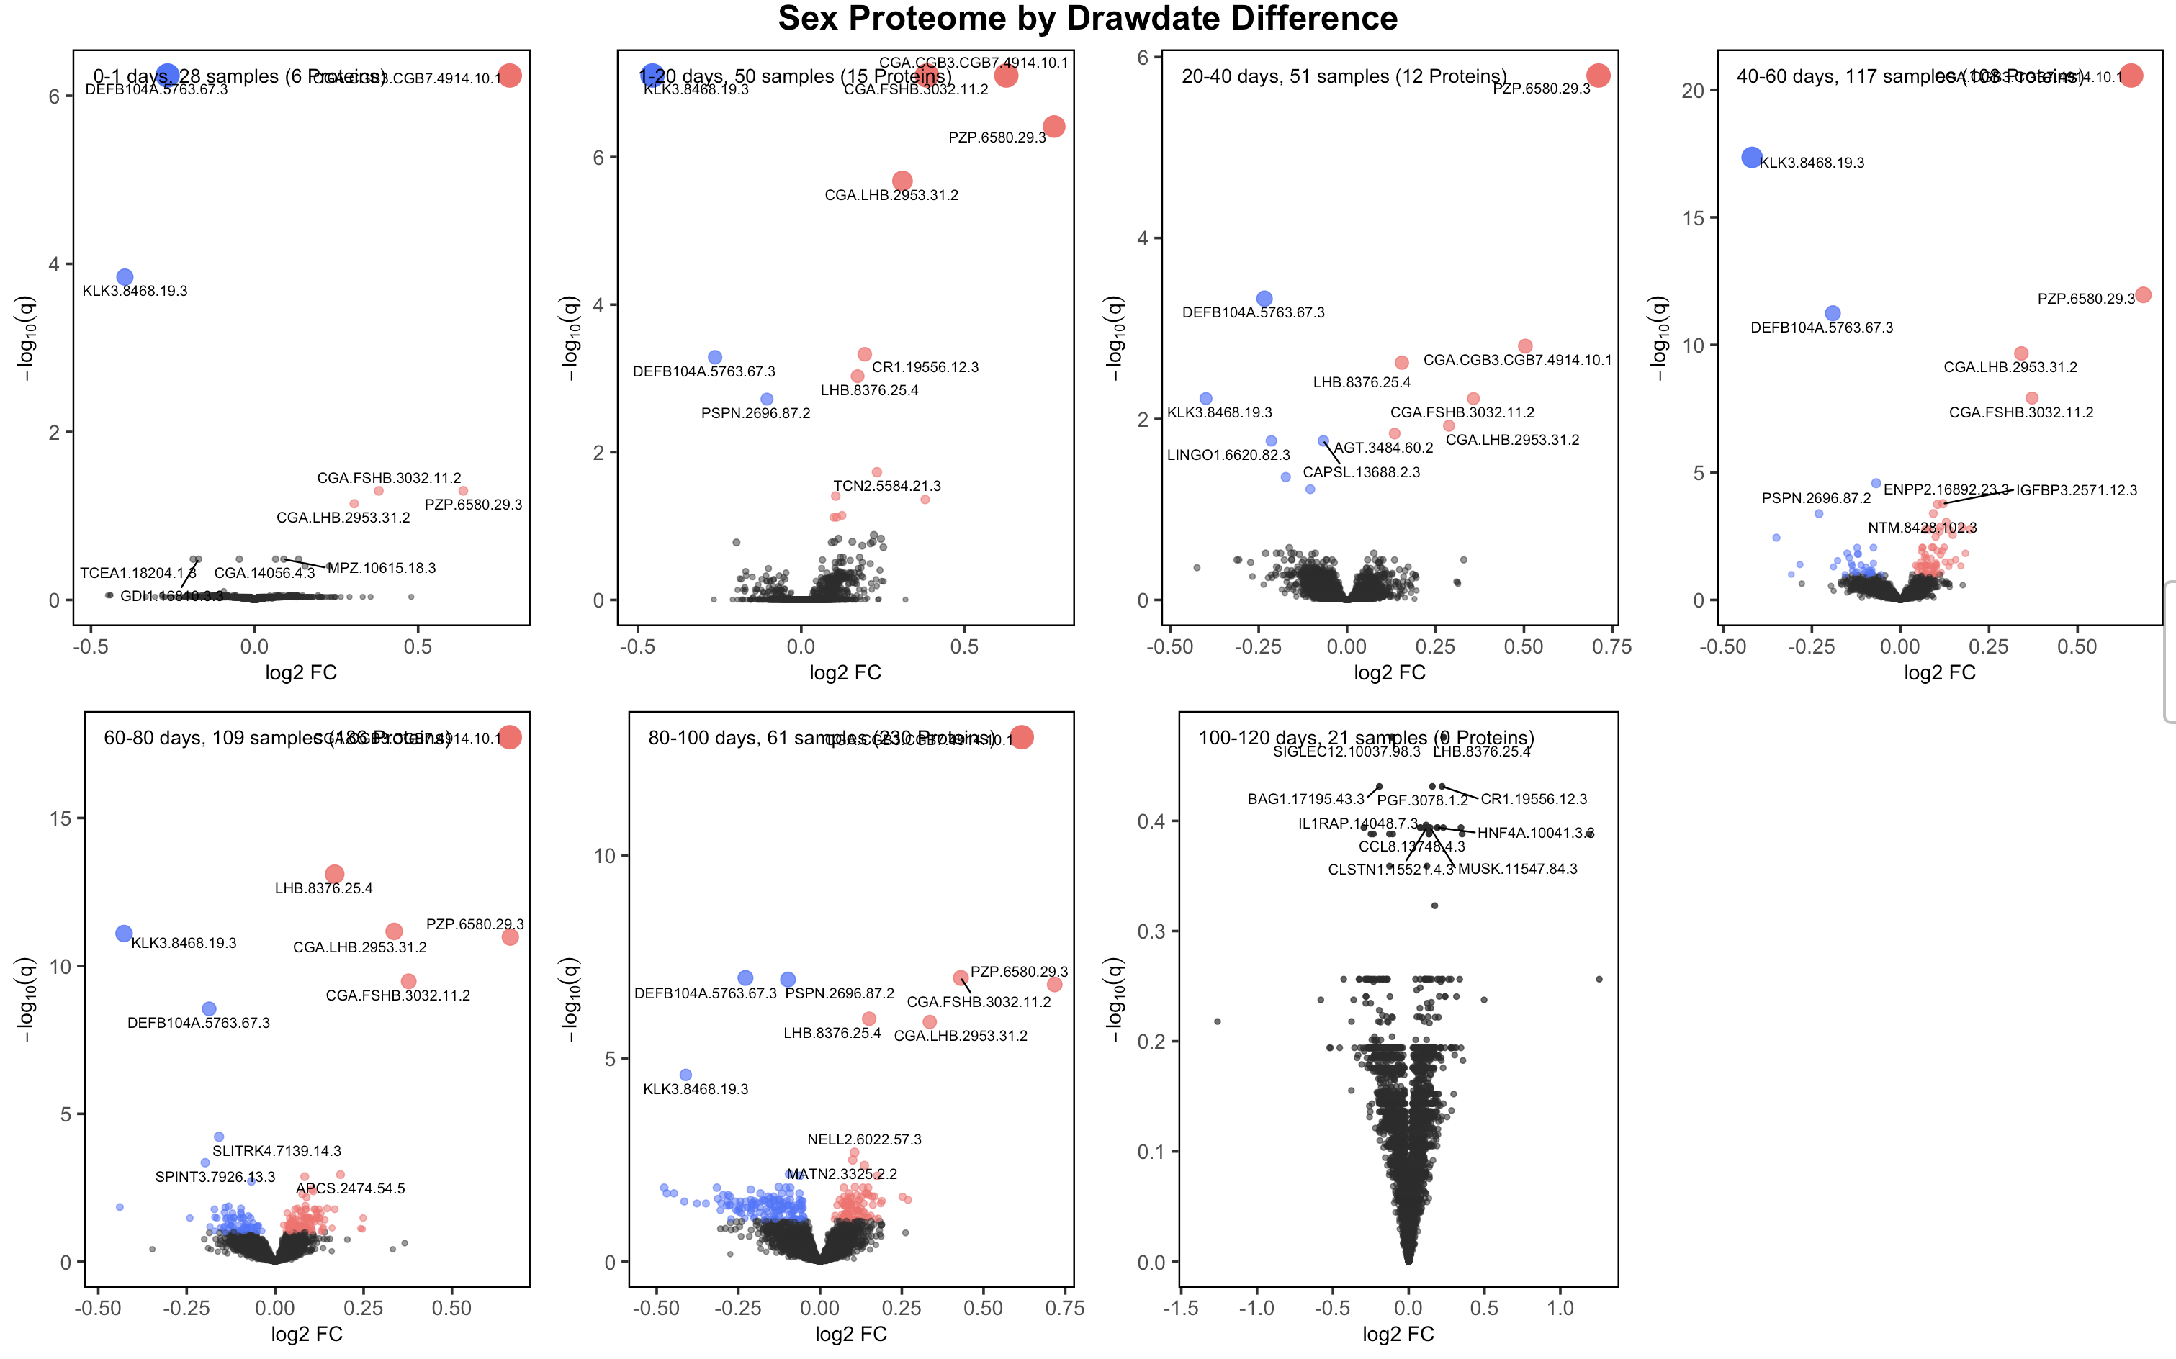
1. Log Raw Ratio: Sex Proteomes Across Drawdates (20)
Variables: Sex, Age, Drawdate diff, Diagnosis, Storage days, Batch effect

Slide 10
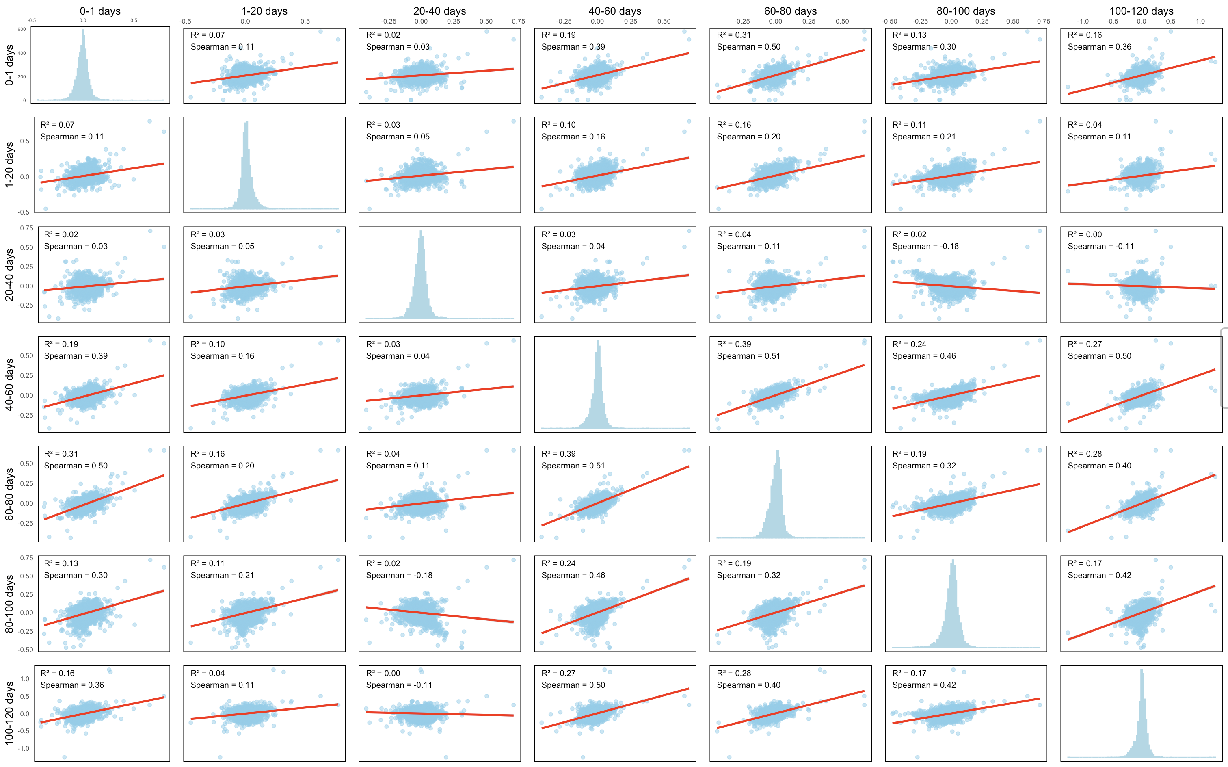
1. Log Raw Ratio: Sex Proteomes Robustness Across Drawdates (20)
-log10(q)
log2fc

Slide 11
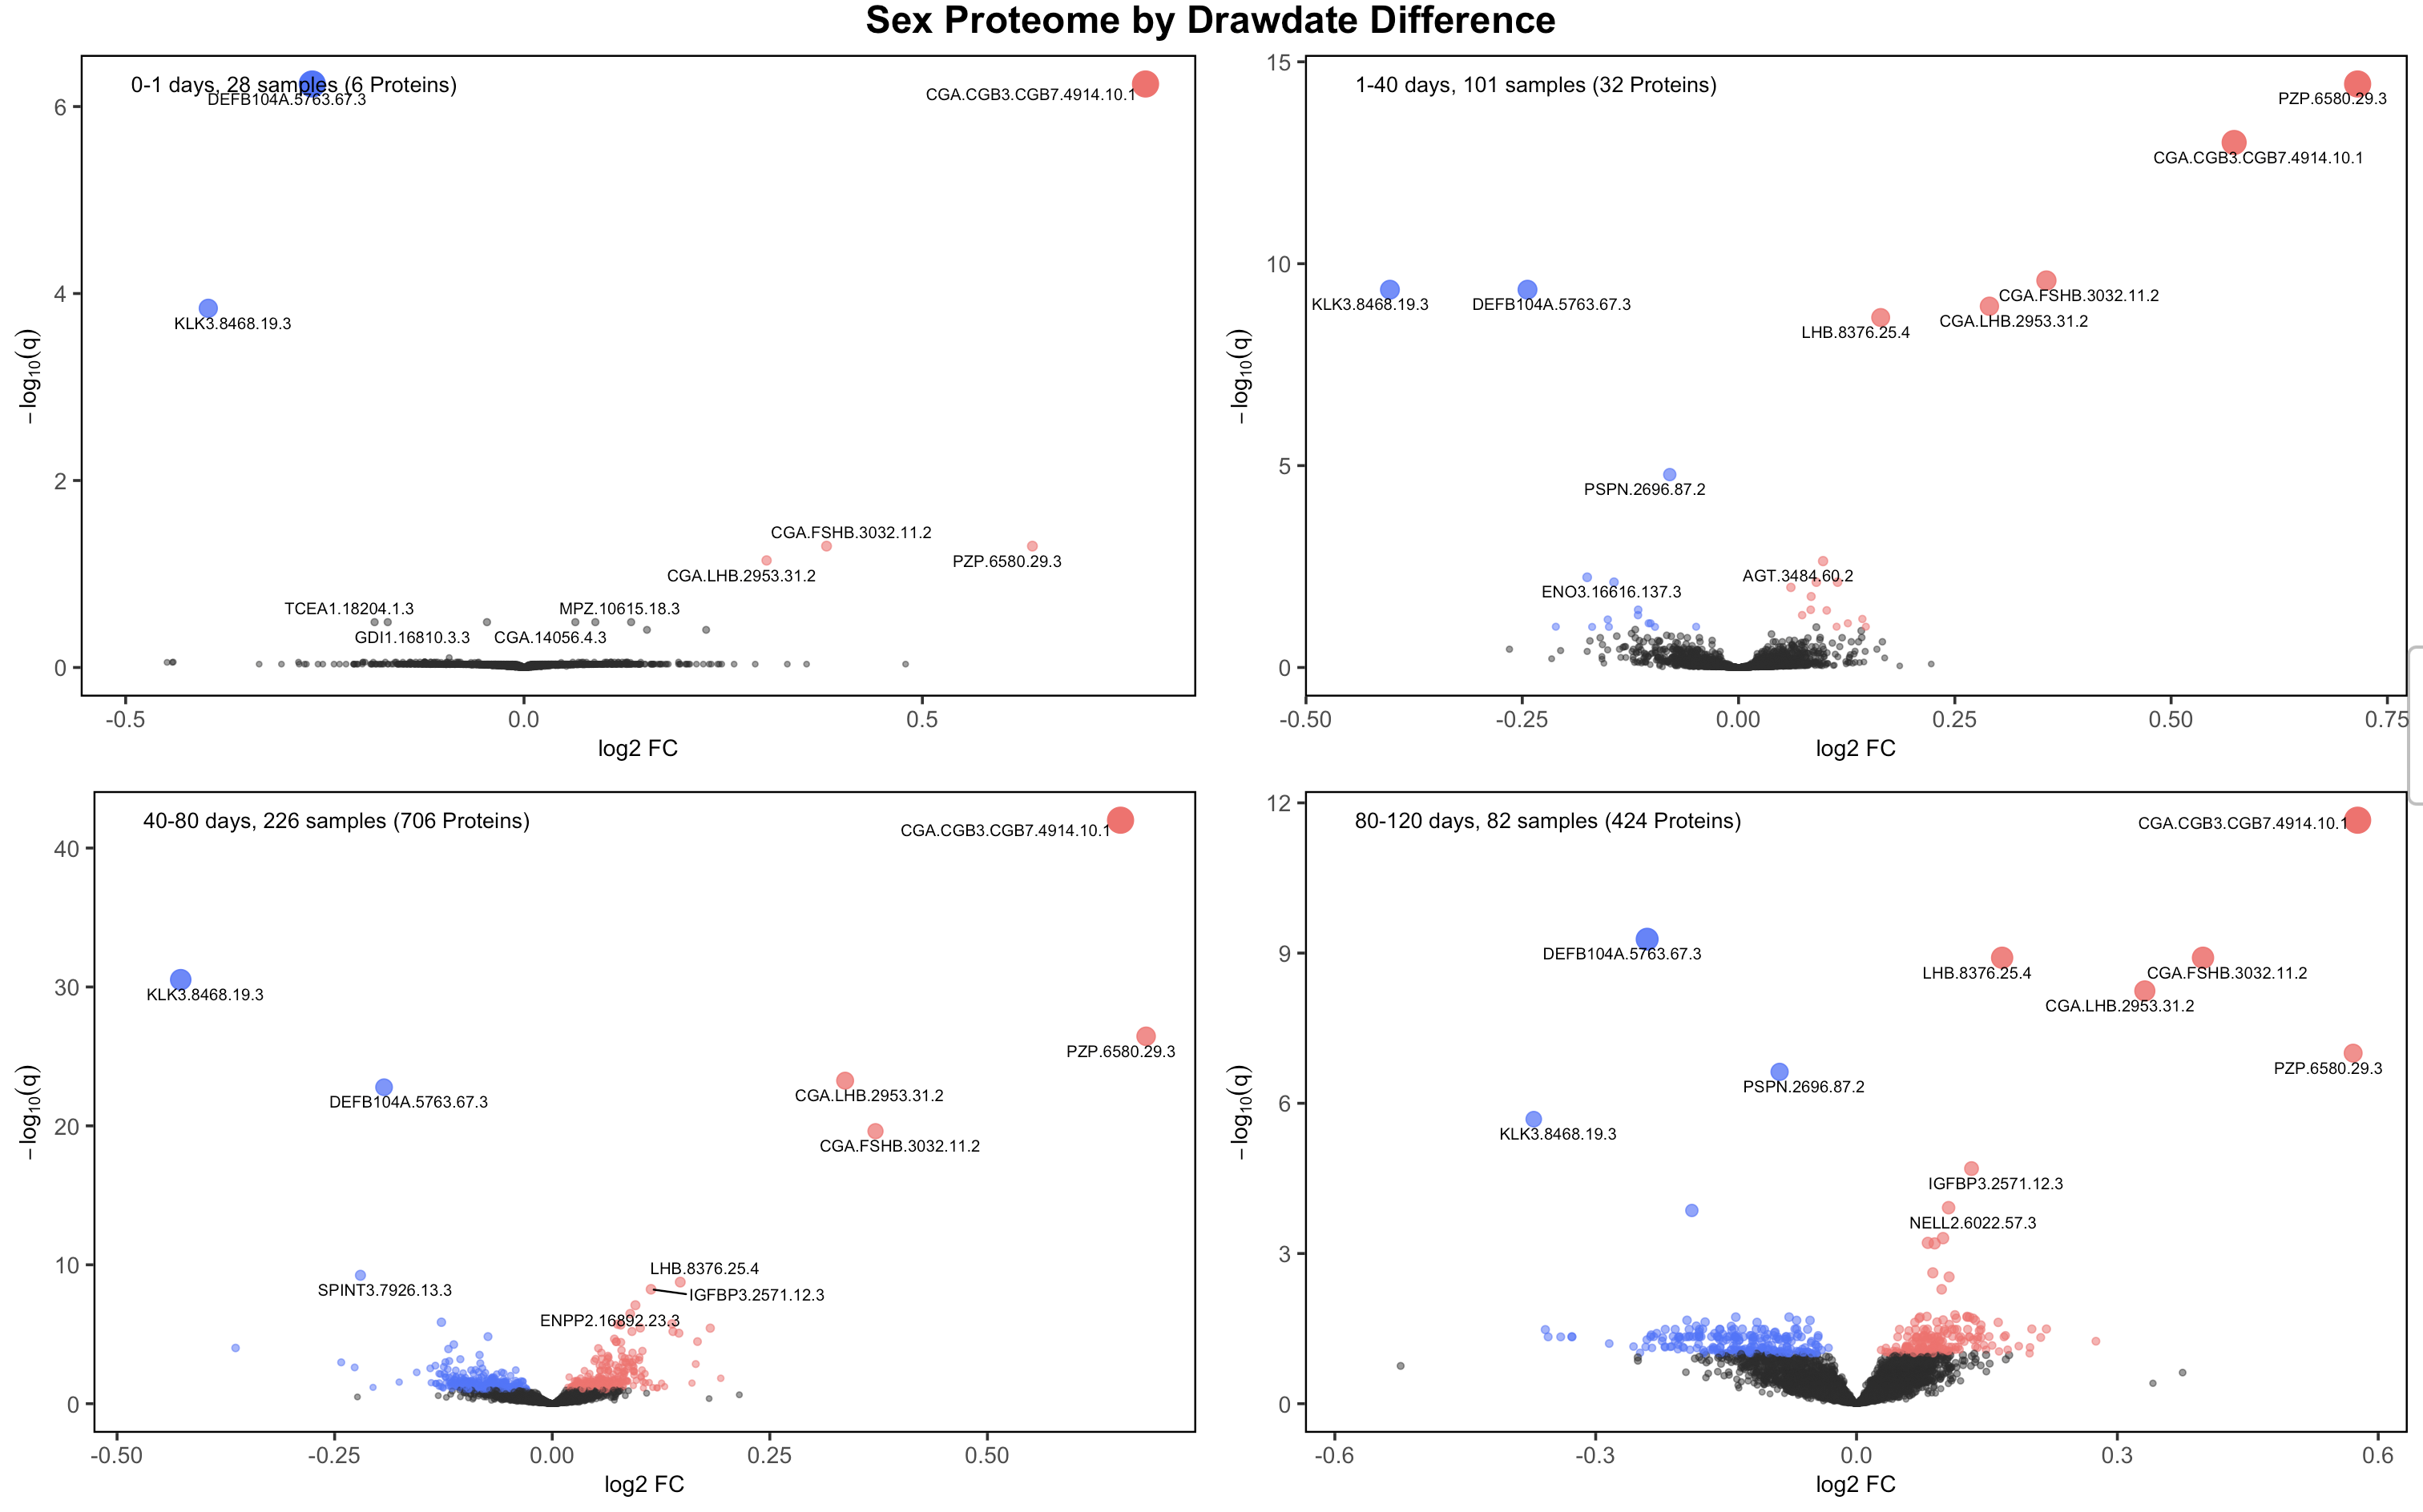
1. Log Raw Ratio: Sex Proteomes Across Drawdates (40)
Variables: Sex, Age, Drawdate diff, Diagnosis, Storage days, Batch effect

Slide 12
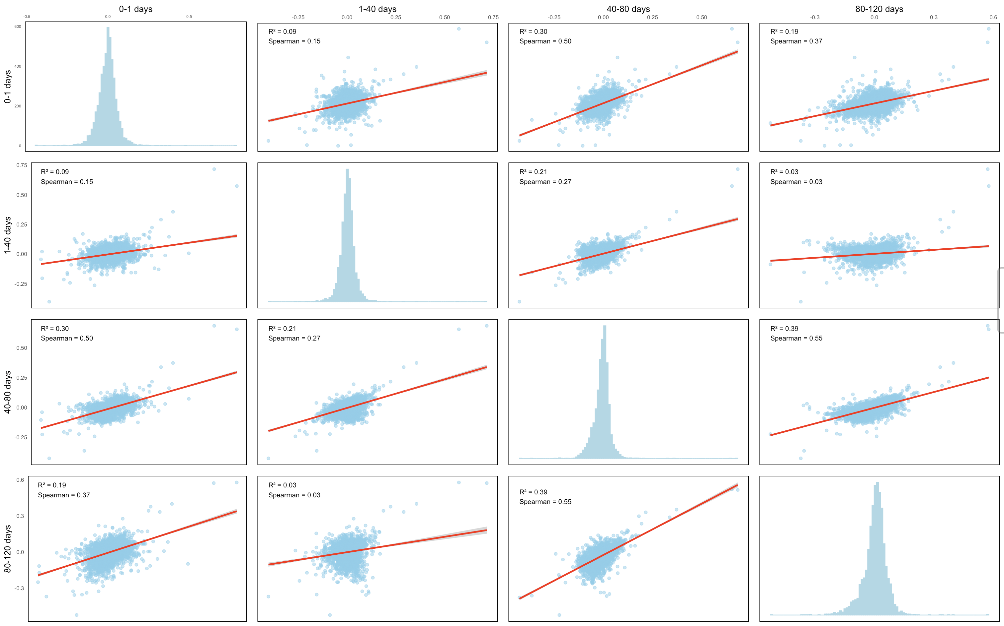
1. Log Raw Ratio: Sex Proteomes Robustness Across Drawdates (40)

Slide 13
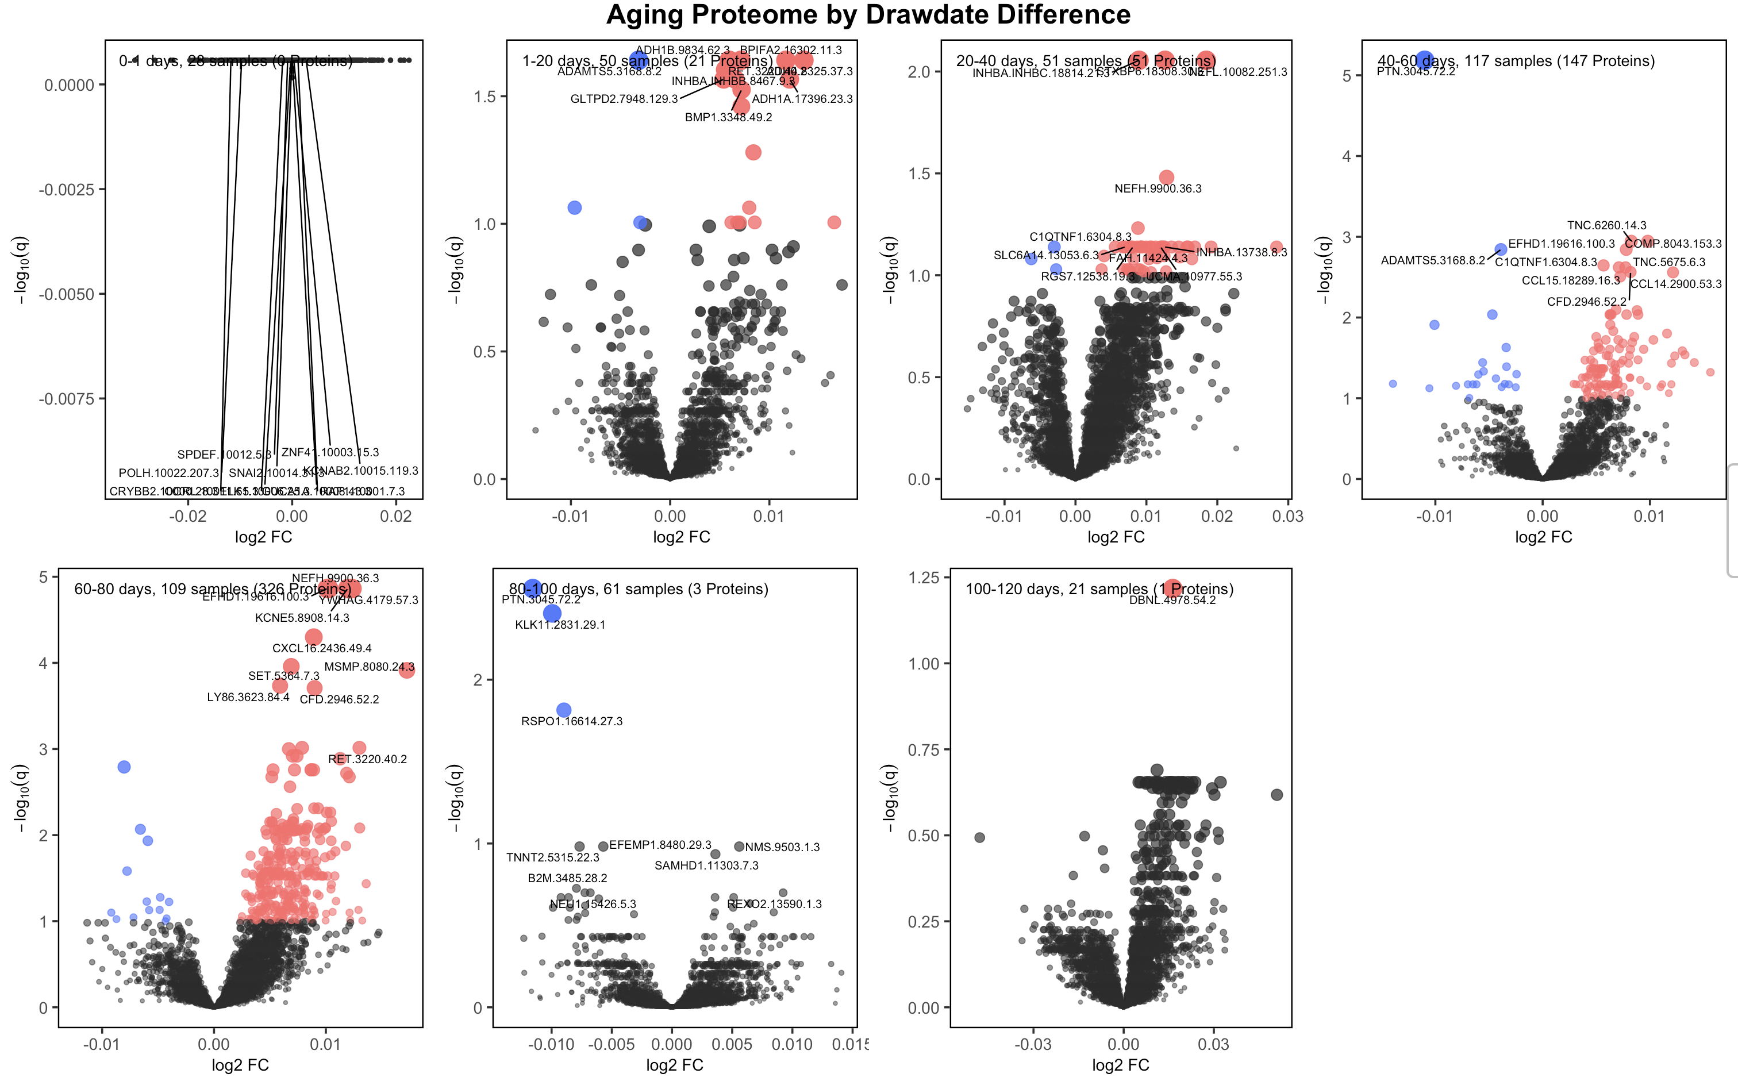
1. Log Raw Ratio: Aging Proteomes Across Drawdates (20)
Variables: Sex, Age, Drawdate diff, Diagnosis, Storage days, Batch effect

Slide 14
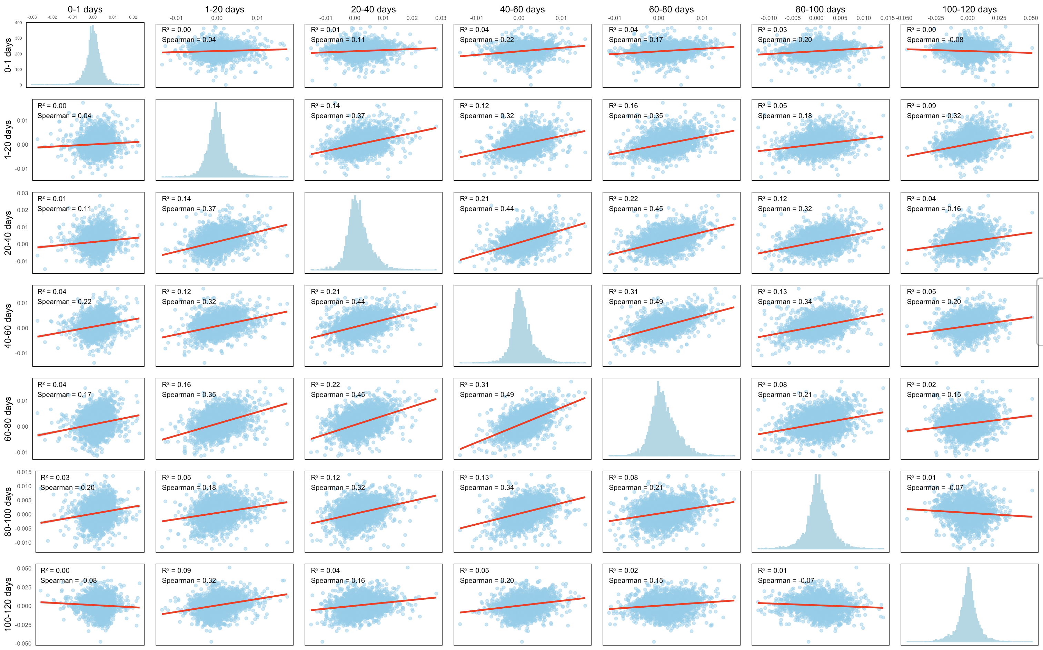
1. Log Raw Ratio: Aging Proteomes Robustness Across Drawdates (20)

Slide 15
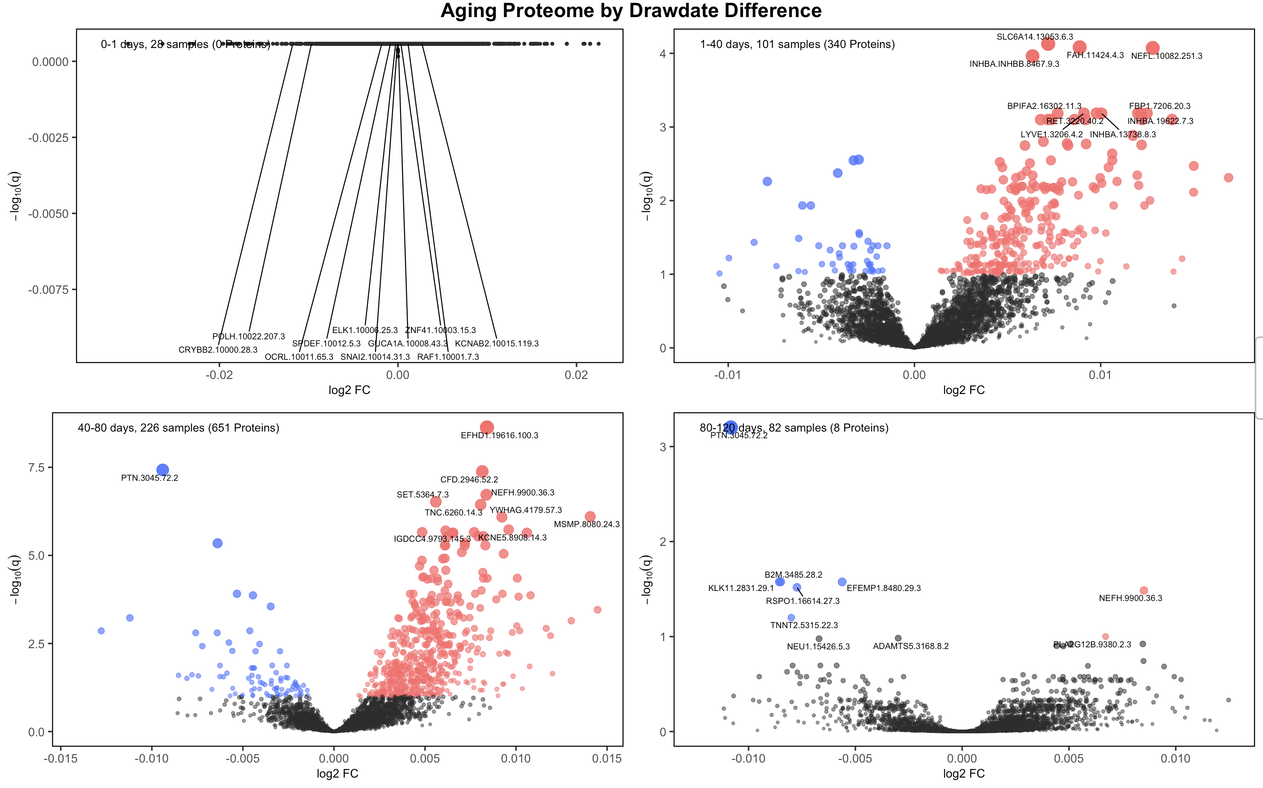
1. Log Raw Ratio: Aging Proteomes Across Drawdates (40)
Variables: Sex, Age, Drawdate diff, Diagnosis, Storage days, Batch effect

Slide 16
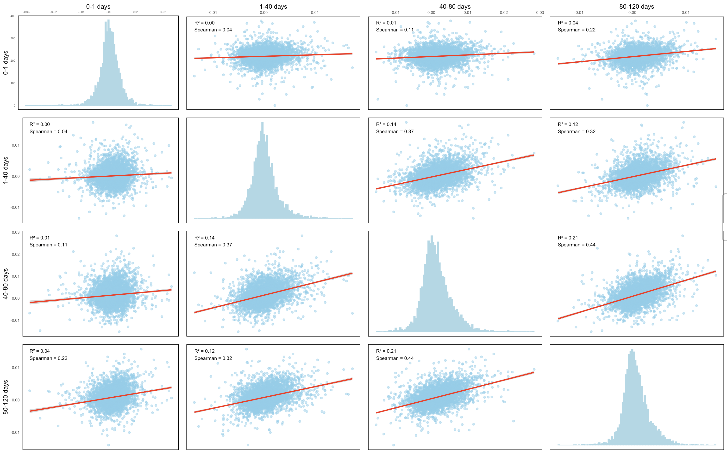
1. Log Raw Ratio: Aging Proteomes Corr. Across Drawdates (40)

Slide 17
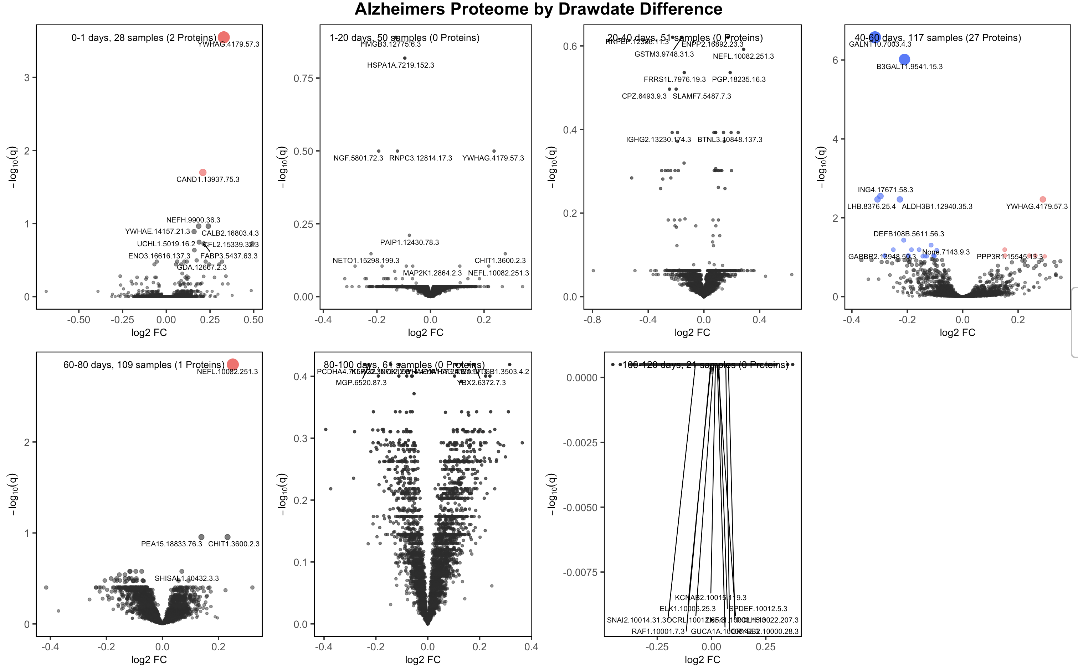
1. Log Raw Ratio: AD Proteomes Across Drawdates (20)
Variables: Sex, Age, Drawdate diff, Diagnosis, Storage days, Batch effect

Slide 18
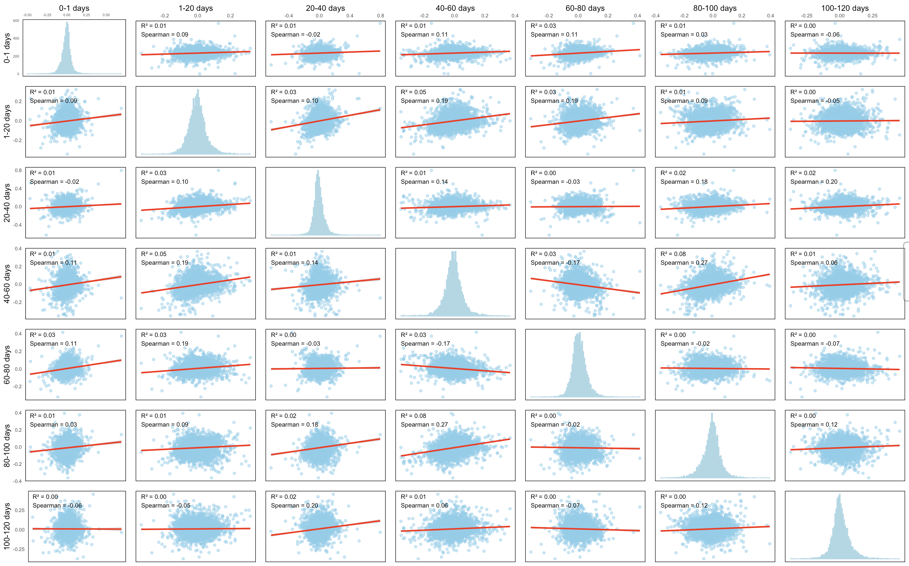
1. Log Raw Ratio: AD Proteomes Corr. Across Drawdates (20)
log2fc
-log10(q)

Slide 19
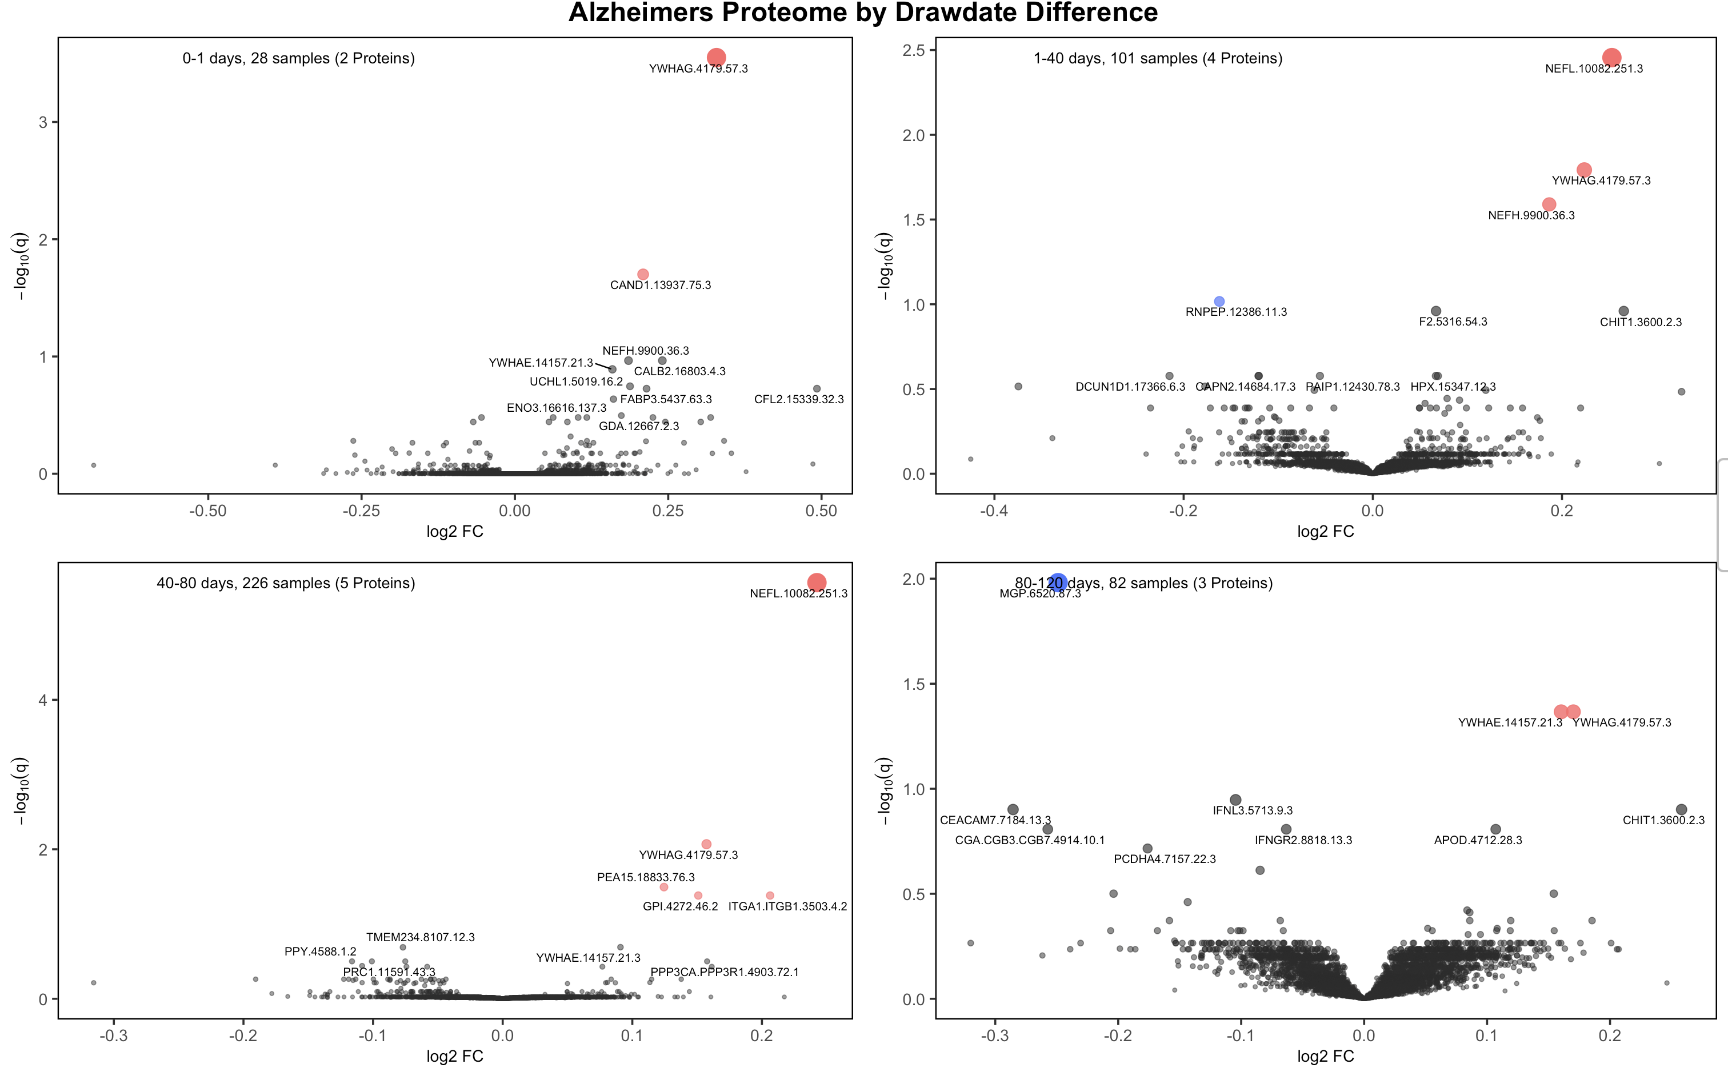
1. Log Raw Ratio: AD Proteomes Across Drawdates (40)
Variables: Sex, Age, Drawdate diff, Diagnosis, Storage days, Batch effect

Slide 20
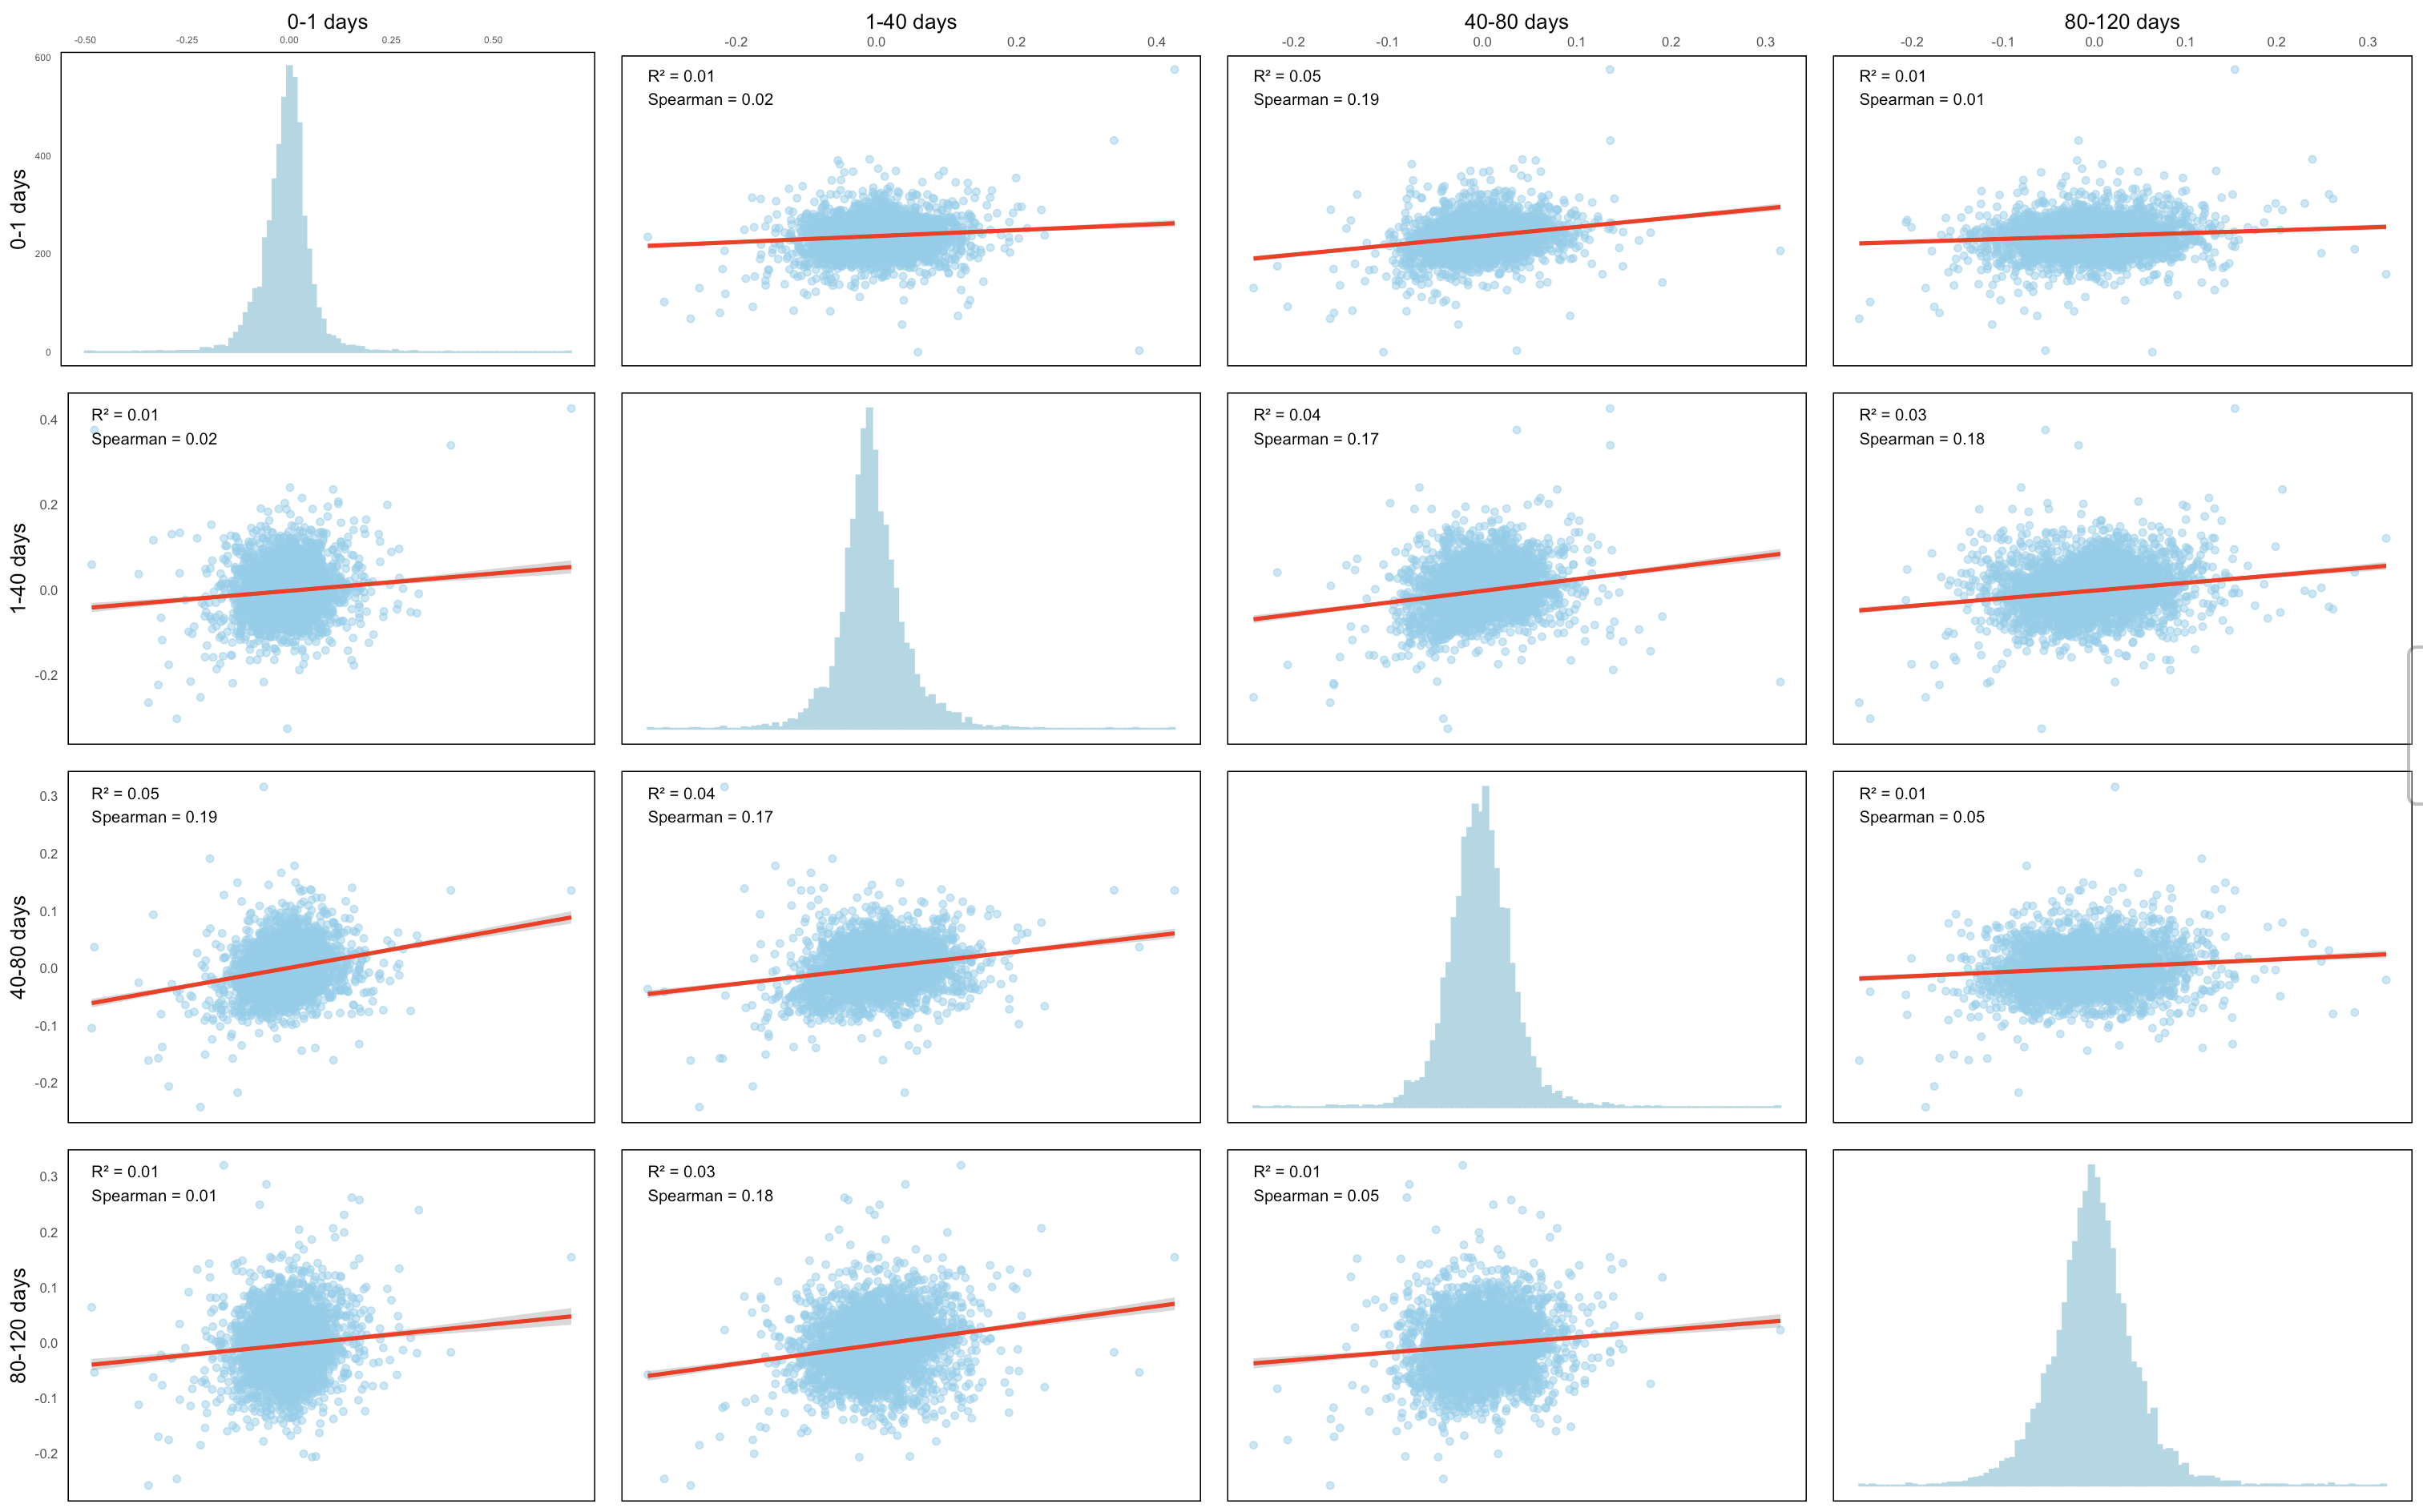
1. Log Raw Ratio: AD Proteomes Corr. Across Drawdates (40)

Slide 21
Maybe Batch Effect?

Slide 22
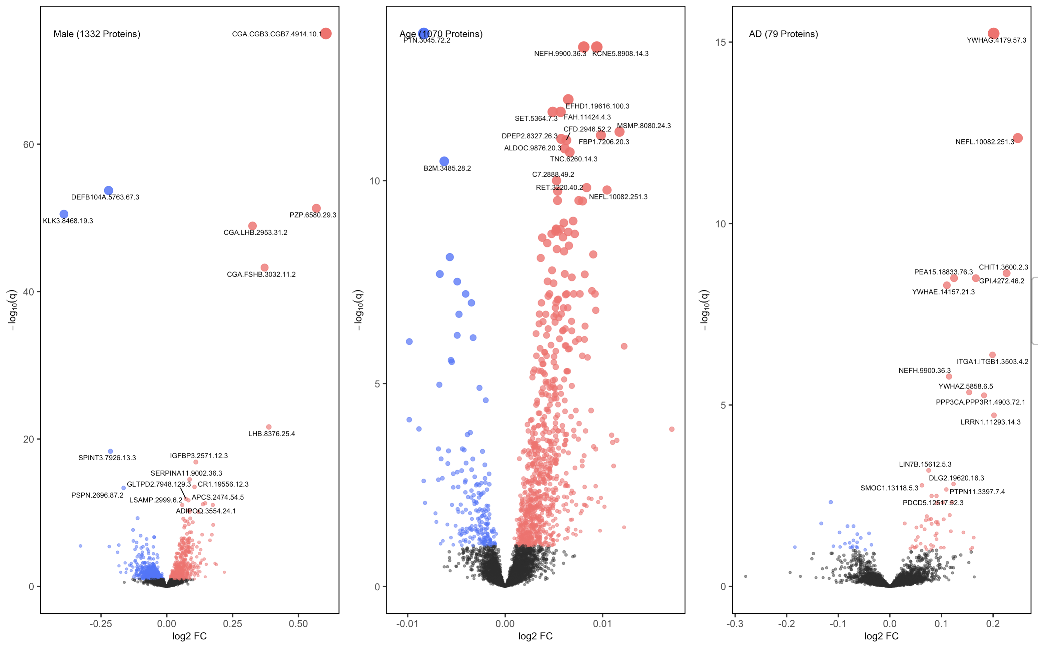
1. Log Raw Ratio w/ ComBat
Variables: Sex, Age, Drawdate diff, Diagnosis, Storage days, Batch effect

Slide 23
1. Log Raw Ratio: Linear Batch Effect Removal VS ComBat
Linear Modeling
ComBat + Linear Modeling
Very small differences, consistent top hits
Question: ComBat reduces some expression levels to below 0, so how to apply logarithm?
Variables: Sex, Age, Drawdate diff, Diagnosis, Storage days, Batch effect

Slide 24
Maybe reconsider how we test
robustness / how we pick samples

Slide 25
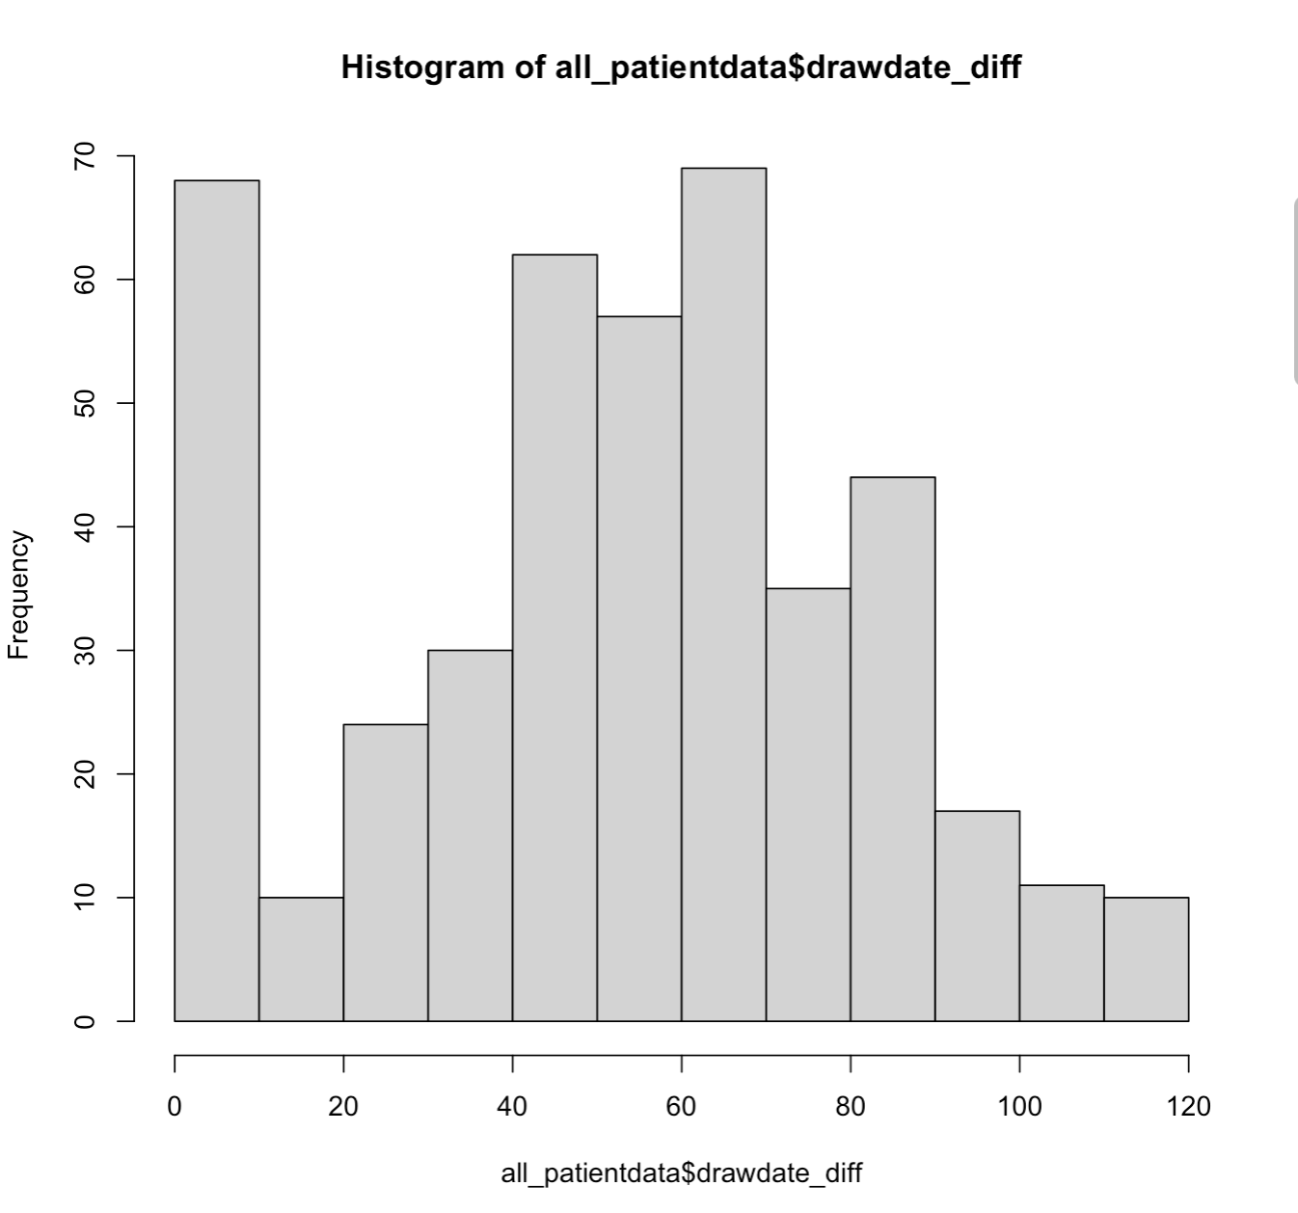
Few Ideas about Testing Robustness
Note that data is pretty
sparse in the tail
- Maybe weak correlation b/w different drawdate groups have more to do with our way of partitioning or our way
of sampling from the total dataset? (Extreme example: drawdate interval = 1 day / very few AD samples)
- Ultimately we want to show that we get replicable results within our sample from the total dataset. This doesn’t
necessitate we use even drawdate intervals. In fact, based on how we sample from entire dataset, we don’t
have to use drawdate difference either.
- Suggestions: 1. Intervals cut off by # of samples instead of drawdate
2. Larger drawdate difference (<180?), but also larger drawdate difference (elaborate later)
3. Sample using different criteria (elaborate later)

Slide 26
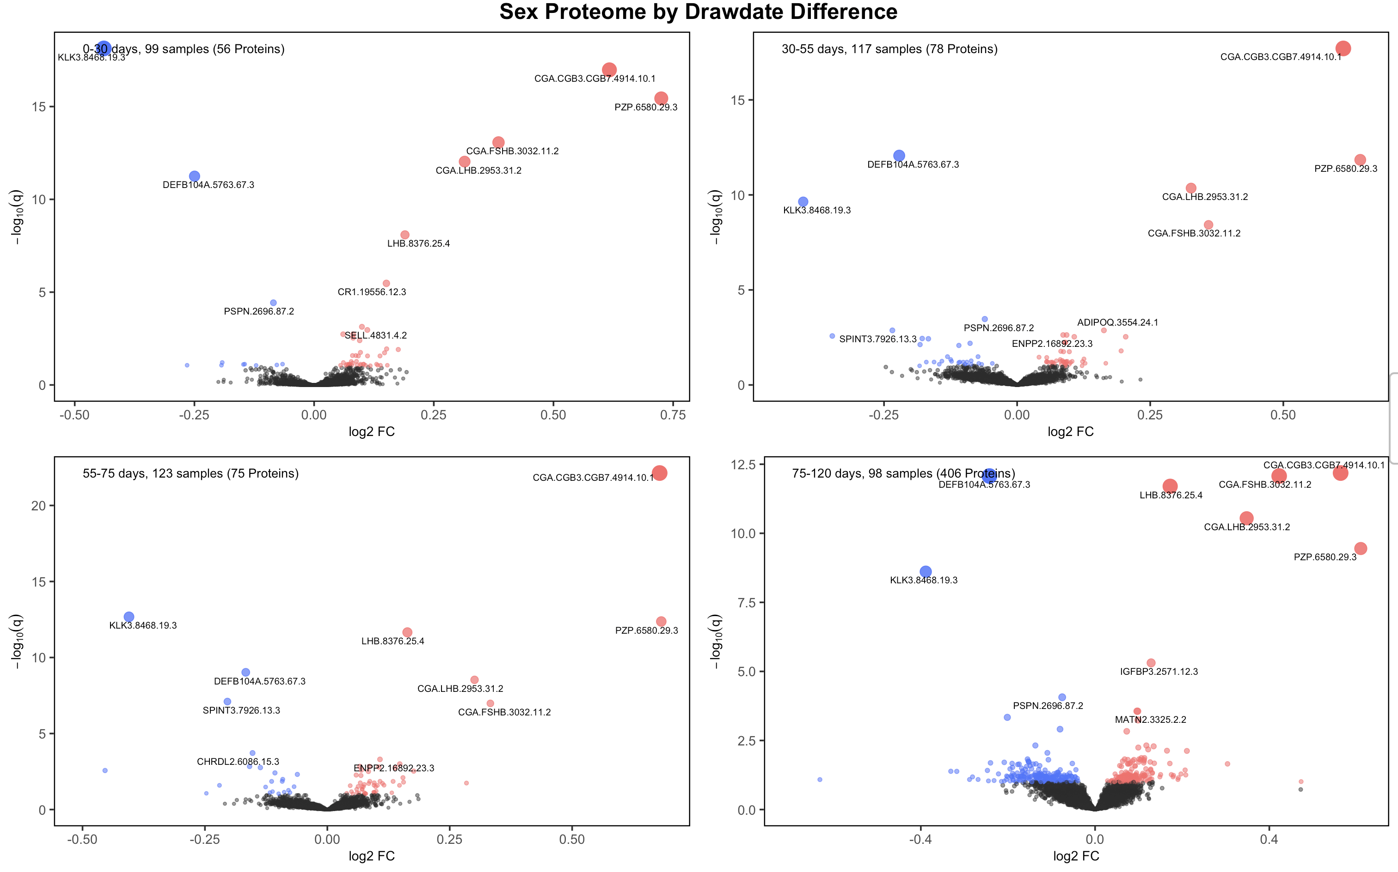
1. Log Raw Ratio: Sex Proteomes Across Uneven Drawdates (~100 Samples)
Variables: Sex, Age, Drawdate diff, Diagnosis, Storage days, Batch effect

Slide 27
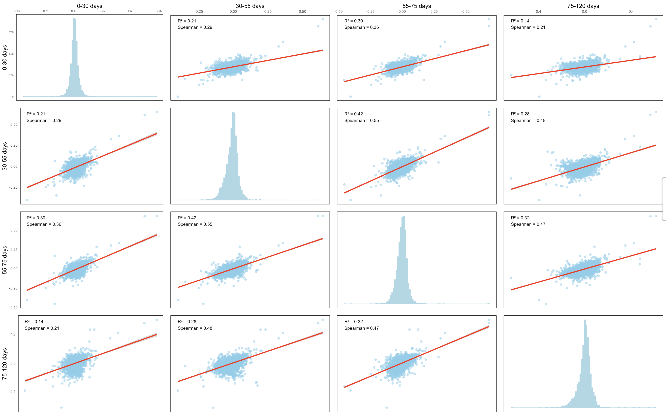
1. Log Raw Ratio: Sex Proteomes Corr. Across Uneven Drawdates (~100 Samples)

Slide 28
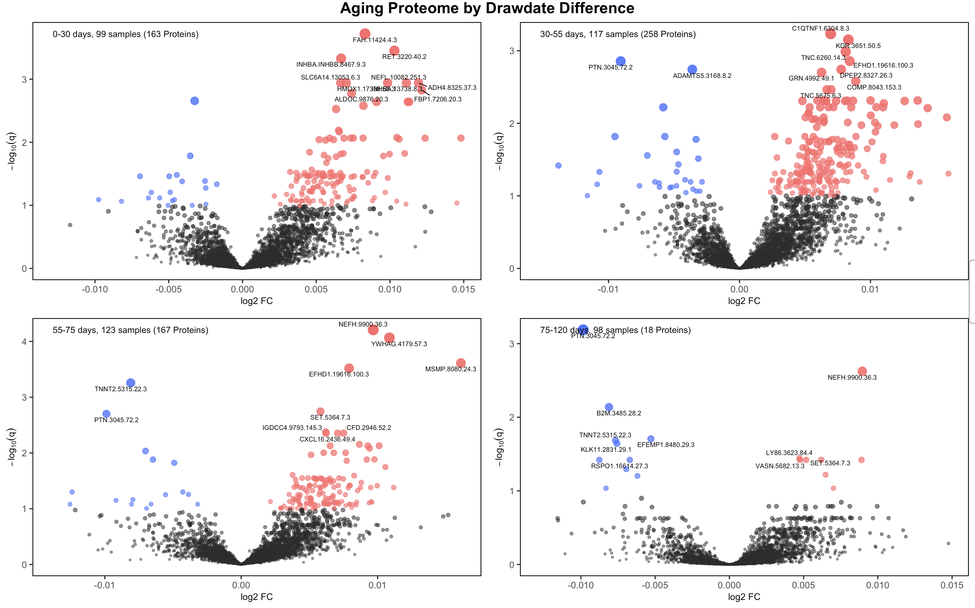
1. Log Raw Ratio: Aging Proteomes Across Uneven Drawdates (~100 Samples)
Variables: Sex, Age, Drawdate diff, Diagnosis, Storage days, Batch effect

Slide 29
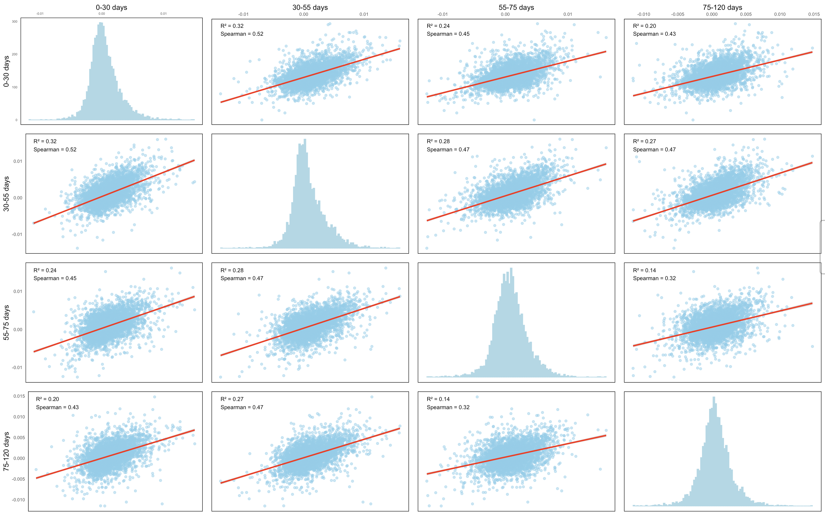
1. Log Raw Ratio: Aging Proteomes Corr. Across Uneven Drawdates (~100 Samples)

Slide 30
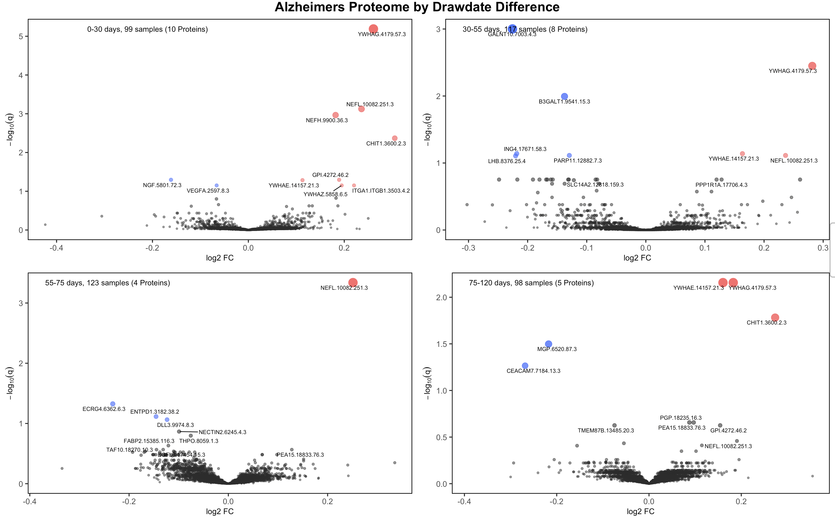
1. Log Raw Ratio: AD Proteomes Across Uneven Drawdates (~100 Samples)
Variables: Sex, Age, Drawdate diff, Diagnosis, Storage days, Batch effect

Slide 31
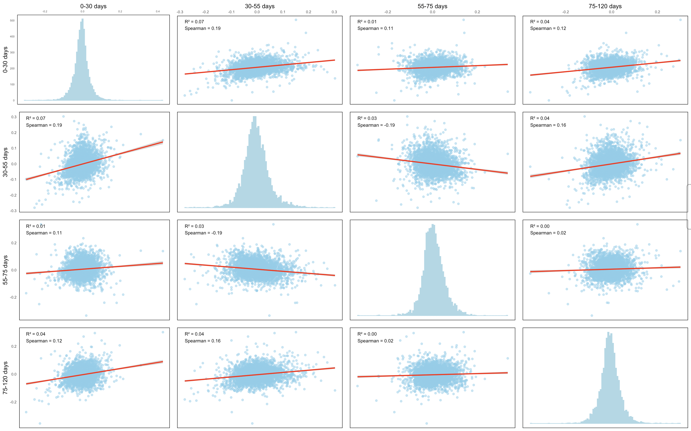
1. Log Raw Ratio: AD Proteomes Corr. Across Uneven Drawdates (~100 Samples)

Slide 32
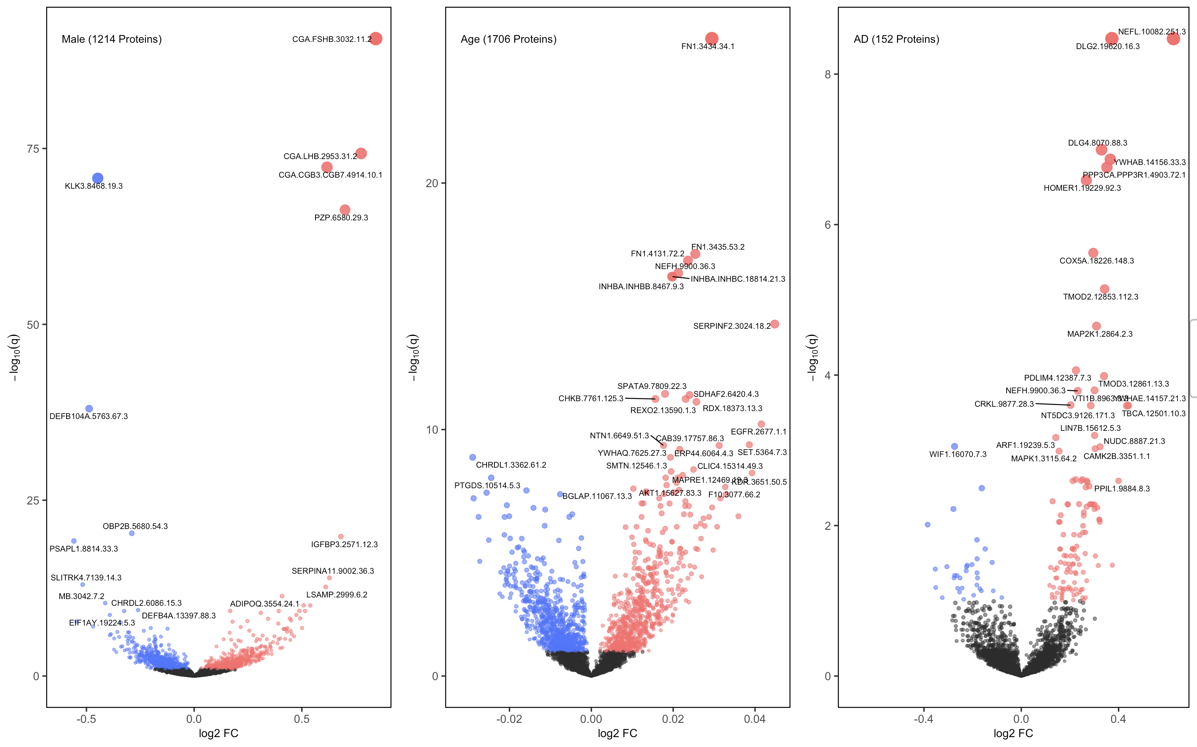
2. Z-Score then log(Rank Ratio)
Variables: Sex, Age, Drawdate diff, Diagnosis, Storage days, Batch effect

Slide 33
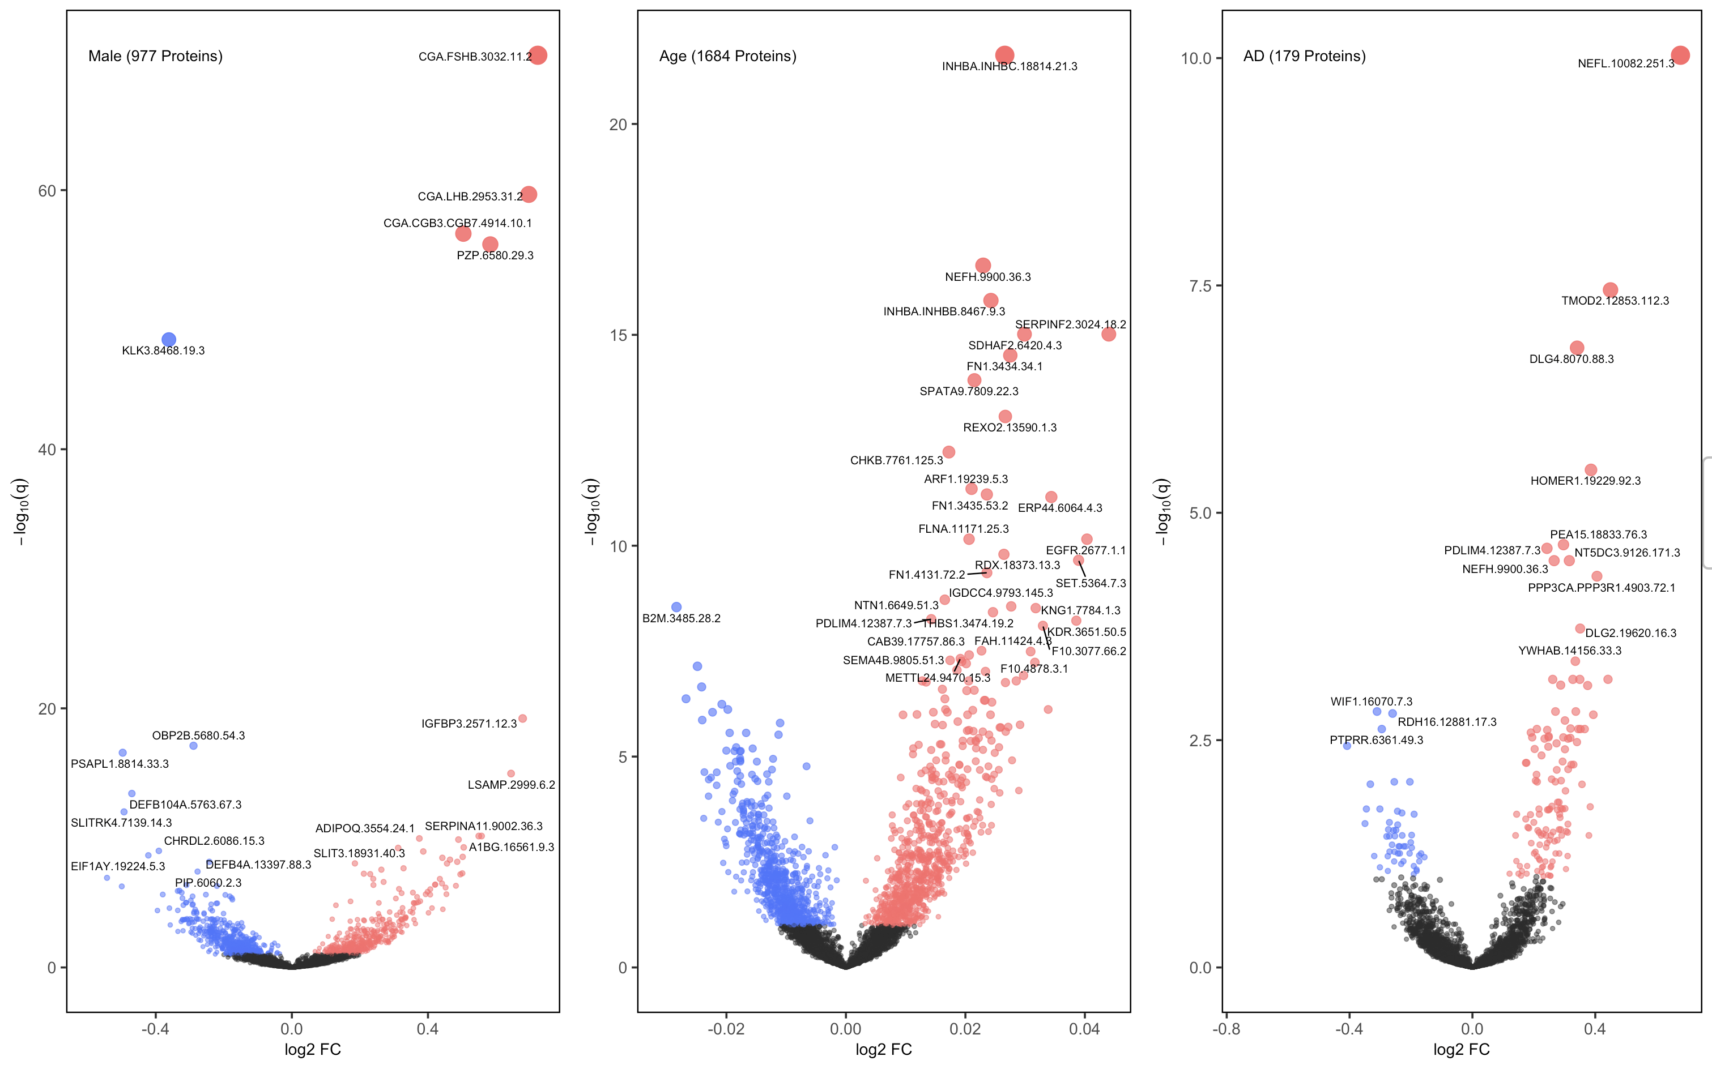
2. Z-Score then log(Rank Ratio) w/ ComBat
Variables: Sex, Age, Drawdate diff, Diagnosis, Storage days, Batch effect

Slide 34
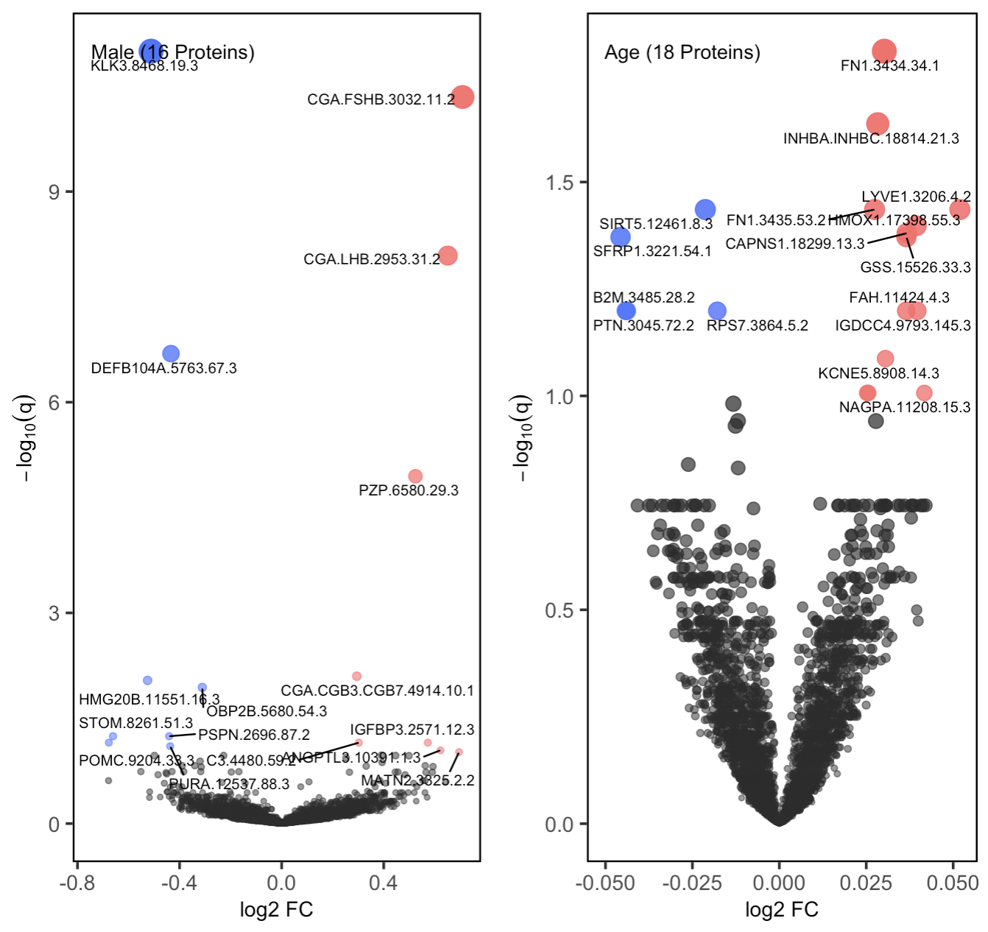
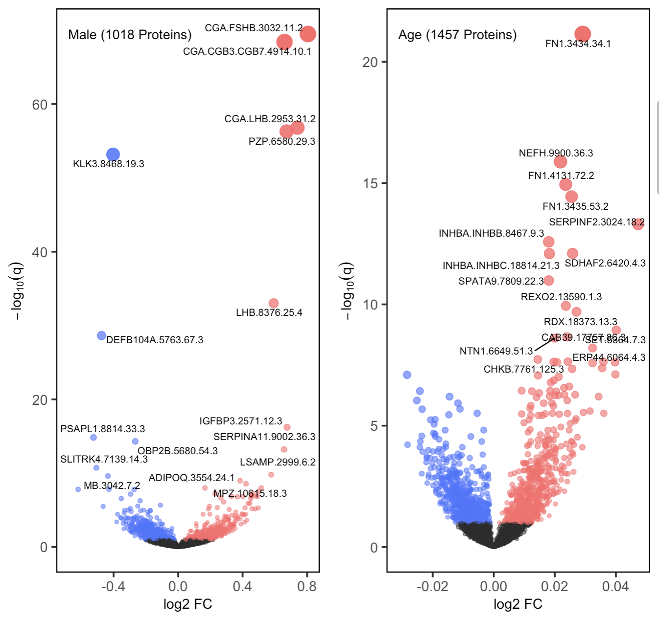
2. Z-Score then log(Rank Ratio): Stratified by Diagnosis
AD Group
CO Group
Variables: Sex, Age, Drawdate diff, Storage days, Batch effect

Slide 35
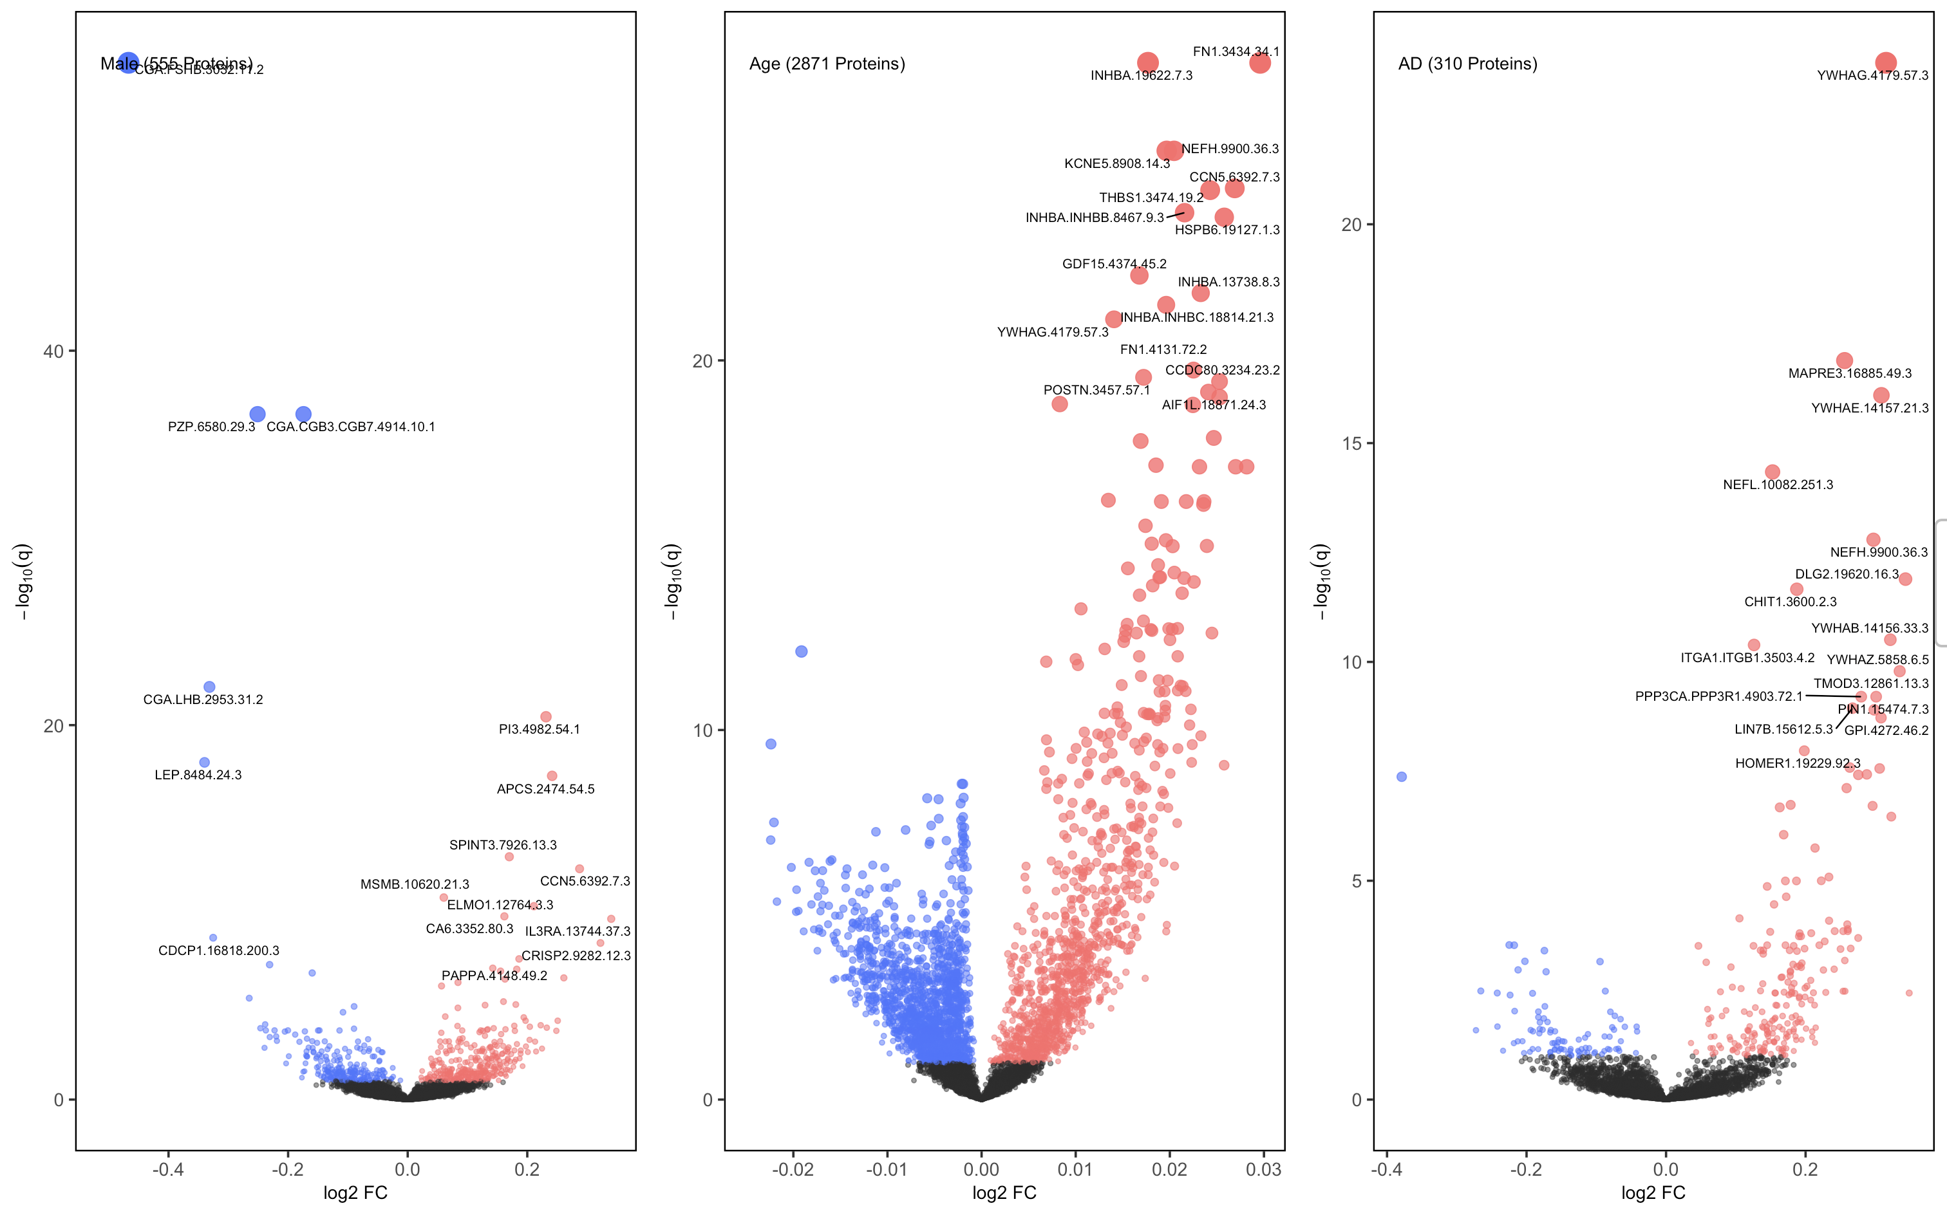
2. Z-Score then log(Rank Ratio): Sanity Check using CSF
Variables: Sex, Age, Drawdate diff, Diagnosis, Storage days, Batch effect

Slide 36
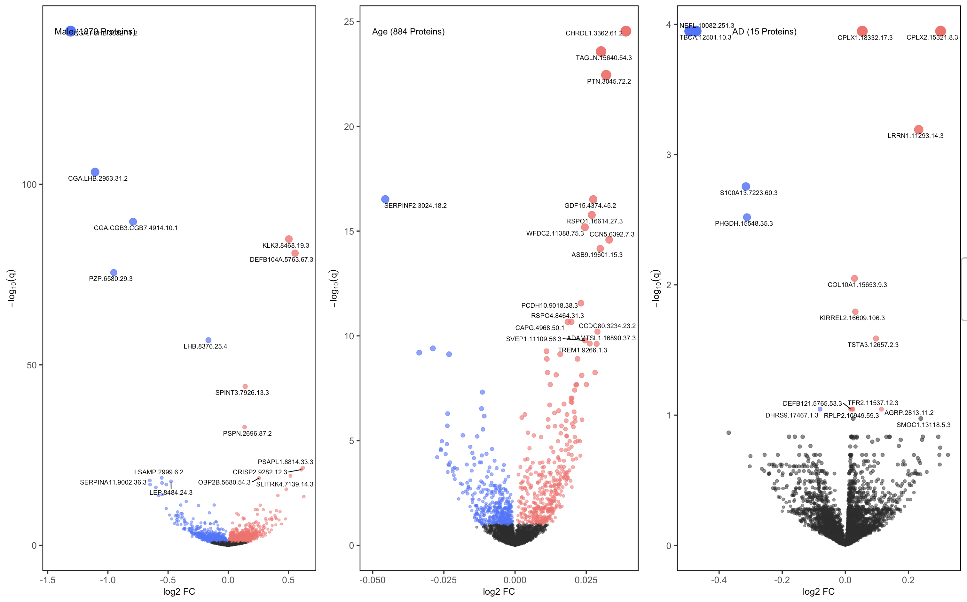
2. Z-Score then log(Rank Ratio): Sanity Check using Raw Plasma
Variables: Sex, Age, Drawdate diff, Diagnosis, Storage days, Batch effect

Slide 37
2. Z-Score then log(Rank Ratio): Sex Proteomes Across Drawdates (40)
Variables: Sex, Age, Drawdate diff, Diagnosis, Storage days, Batch effect

Slide 38
2. Z-Score then log(Rank Ratio): Sex Proteomes Corr. Across Drawdates (40)
-log10(q)
log2fc

Slide 39
2. Z-Score then log(Rank Ratio): Sex Proteomes Across Drawdates (40)
Variables: Sex, Age, Drawdate diff, Diagnosis, Storage days, Batch effect

Slide 40
2. Z-Score then log(Rank Ratio): Sex Proteomes Corr. Across Drawdates (40)

Slide 41
Summary!

Slide 42
# of Signals
 | log(ratio) | log(ratio) w/ ComBat | log(z-scored rank ratio) | log(z-scored rank ratio) w/ ComBat | z-scored rank diff | z-scored rank diff w/ ComBat
Sex | 1325 | 1332 | 1214 | 977 | 1487 | 1232
Aging | 1127 | 1070 | 1706 | 1684 | 1826 | 2000
AD | 83 | 79 | 152 | 179 | 272 | 237
Top 5 Signals
Sex ⬆️ (M) | CGA.CGB3.CGB7 PZP CGA.LHB | CGA.CGB3.CGB7 PZP CGA.LHB | CGA.FSHB CGA.LHB CGA.CGB3.CGB7 | CGA.FSHB CGA.LHB CGA.CGB3.CGB7 | CGA.FSHB CGA.CGB3.CGB7 PZP | CGA.LHB PZP CGA.FSHB
Sex ⬇️ (F) | KLK3 DEFB104A SPINT3 | DEFB104A KLK3 SPINT3 | KLK3 DEFB104A OBP2B | KLK3 OBP2B PSAPL1 | DEFB104A KLK3 OBP2B | KLK3 DEFB104A OBP2B
Age ⬆️ | NEFH KCNE5 EFHD1 | KCNE5 NEFH EFHD1 | FN1.3434.34.1 FN1.3435.53.2 FN1.4131.72.2 | INHBA.INHBC NEFH INHBA | FN1.3434.34.1 FN1.3435.53.2 FN1.4131.72.2 | INHBA.INHBC FN1.3434.34.1 FN1.4131.72.2
Age ⬇️ | PTN B2M PTGDS | PTN B2M RSPO1 | CHRDL1 PTGDS BGLAP | B2M | PTN ADAMTS B2M | B2M PTN ATG3
AD ⬆️ (AD) | NEFL YWHAG CHIT1 | YWHAG NEFL CHIT1 | NEFL DLG2 DLG4 | NEFL TMOD2 DLG4 | DLG4 NEFL PPP3CA | NEFL DLG4 TMOD2
AD ⬇ ️ (CO) | NPTX2 CCK DLK2 | NPTX2 EVA1B CCK |  | WIF1 RDH16 PTPRR

Slide 43
GO_Biological_Process_2023
 | log(ratio) | log(ratio) w/ ComBat | log(z-scored rank ratio) | log(z-scored rank ratio) w/ ComBat | z-scored rank diff | z-scored rank diff w/ ComBat
Sex ⬆️ (M) | [1] "Cytokine-Mediated Signaling Pathway (GO:0019221)" [2] "Positive Regulation Of MAPK Cascade (GO:0043410)" [3] "Positive Regulation Of Protein Phosphorylation (GO:0001934)" | [1] "Cytokine-Mediated Signaling Pathway (GO:0019221)" [2] "Positive Regulation Of MAPK Cascade (GO:0043410)" [3] "Positive Regulation Of Protein Phosphorylation (GO:0001934)" | [1] "Positive Regulation Of Protein Phosphorylation (GO:0001934)" [2] "Positive Regulation Of MAPK Cascade (GO:0043410)" [3] "Positive Regulation Of Peptidyl-Tyrosine Phosphorylation (GO:0050731)" | [1] "Cytokine-Mediated Signaling Pathway (GO:0019221)" [2] "Positive Regulation Of Cytokine Production (GO:0001819)" [3] "Regulation Of Endopeptidase Activity (GO:0052548)" | [1] "Cytokine-Mediated Signaling Pathway (GO:0019221)” [2] "Lymphocyte Chemotaxis (GO:0048247)" [3] "Positive Regulation Of MAPK Cascade (GO:0043410)" | [1] "Cytokine-Mediated Signaling Pathway (GO:0019221)" [2] "Negative Regulation Of Blood Coagulation (GO:0030195)" [3] "Lymphocyte Chemotaxis (GO:0048247)"
Sex ⬇️ (F) | [1] "Negative Regulation Of Apoptotic Process (GO:0043066)" [2] "Regulation Of MAPK Cascade (GO:0043408)" [3] "Protein Modification Process (GO:0036211)" | [1] "Negative Regulation Of Apoptotic Process (GO:0043066)” [2] "Glucose Metabolic Process (GO:0006006)" [3] "Glycolytic Process (GO:0006096)" | [1] "Negative Regulation Of Apoptotic Process (GO:0043066)" [2] "Negative Regulation Of Programmed Cell Death (GO:0043069)" [3] "Positive Regulation Of Cellular Process (GO:0048522)" | [1] "Negative Regulation Of Apoptotic Process (GO:0043066)” [2] "Semaphorin-Plexin Signaling Pathway (GO:0071526)" [3] "Nucleotide Metabolic Process (GO:0009117)" | [1] "Negative Regulation Of Apoptotic Process (GO:0043066)" [2] "Negative Regulation Of Programmed Cell Death (GO:0043069)" [3] "Semaphorin-Plexin Signaling Pathway (GO:0071526)" | [1] "Semaphorin-Plexin Signaling Pathway (GO:0071526)" "Negative Regulation Of Apoptotic Process (GO:0043066)" [3] "Glycolytic Process (GO:0006096)"
Age ⬆️ | [1] "Positive Regulation Of MAPK Cascade (GO:0043410)" [2] "Negative Regulation Of Blood Coagulation (GO:0030195)" [3] "Extracellular Matrix Organization (GO:0030198)" | [1] "Extracellular Matrix Organization (GO:0030198)" [2] "Positive Regulation Of MAPK Cascade (GO:0043410)" [3] "Negative Regulation Of Blood Coagulation (GO:0030195)" | [1] "Regulation Of Cell Migration (GO:0030334)" [2] "Negative Regulation Of Blood Coagulation (GO:0030195)" [3] "Positive Regulation Of Cell Motility (GO:2000147)" | [1] "Positive Regulation Of Protein Phosphorylation (GO:0001934)" [2] "Negative Regulation Of Blood Coagulation (GO:0030195)" [3] "Regulation Of Cell Migration (GO:0030334)" | [1] "Regulation Of Cell Migration (GO:0030334)" [2] "Negative Regulation Of Blood Coagulation (GO:0030195)" [3] "Positive Regulation Of Protein Phosphorylation (GO:0001934)" | [1] "Regulation Of Cell Migration (GO:0030334)" [2] "Positive Regulation Of Protein Phosphorylation (GO:0001934)" [3] "Positive Regulation Of Cell Motility (GO:2000147)"
Age ⬇️ | [1] "Cytokine-Mediated Signaling Pathway (GO:0019221)" [2] "Cellular Response To Cytokine Stimulus (GO:0071345)" [3] "Natural Killer Cell Activation (GO:0030101)" | [1] "Cytokine-Mediated Signaling Pathway (GO:0019221)" [2] "Cellular Response To Cytokine Stimulus (GO:0071345)" [3] "Neutrophil Chemotaxis (GO:0030593)" | [1] "Positive Regulation Of Cell Population Proliferation (GO:0008284)" [2] "Regulation Of Cell Population Proliferation (GO:0042127)" [3] "Cytokine-Mediated Signaling Pathway (GO:0019221)" | [1] "Positive Regulation Of Cell Population Proliferation (GO:0008284)" [2] "Positive Regulation Of Cellular Process (GO:0048522)" [3] "Positive Regulation Of Protein Phosphorylation (GO:0001934)" | [1] "Positive Regulation Of Cell Population Proliferation (GO:0008284)" [2] "Cytokine-Mediated Signaling Pathway (GO:0019221)" [3] "Regulation Of Cell Population Proliferation (GO:0042127)" | [1] "Protein Phosphorylation (GO:0006468)" [2] "Positive Regulation Of Cell Population Proliferation (GO:0008284)" [3] "Regulation Of Cell Population Proliferation (GO:0042127)"
AD ⬆️ (AD) | [1] "Negative Regulation Of Supramolecular Fiber Organization (GO:1902904)" [2] "Cellular Response To Nitrogen Levels (GO:0043562)" [3] "Cellular Response To Nitrogen Starvation (GO:0006995)" | [1] "Cellular Response To Nitrogen Levels (GO:0043562)" [2] "Cellular Response To Nitrogen Starvation (GO:0006995)" [3] "Regulation Of Microtubule Cytoskeleton Organization (GO:0070507)" | [1] "Negative Regulation Of Supramolecular Fiber Organization (GO:1902904)" [2] "Regulation Of Protein Localization To Membrane (GO:1905475)" [3] "Supramolecular Fiber Organization (GO:0097435)" | [1] "Substantia Nigra Development (GO:0021762)" [2] "Negative Regulation Of Cellular Process (GO:0048523)" [3] "Microtubule Polymerization Or Depolymerization (GO:0031109)" | [1] "Gluconeogenesis (GO:0006094)" [2] "Negative Regulation Of Supramolecular Fiber Organization (GO:1902904)" [3] "Hexose Biosynthetic Process (GO:0019319)" | [1] "Hexose Biosynthetic Process (GO:0019319)" [2] "Regulation Of Protein Localization To Membrane (GO:1905475)" [3] "Glycolytic Process (GO:0006096)"
AD ⬇ ️ (CO) | [1] "Positive Regulation Of Cell Junction Assembly (GO:1901890)" [2] "Axonogenesis (GO:0007409)" [3] "Cell Morphogenesis Involved In Neuron Differentiation (GO:0048667)" | [1] "Positive Regulation Of Cell Junction Assembly (GO:1901890)" [2] "Axonogenesis (GO:0007409)" [3] "Cell Morphogenesis Involved In Neuron Differentiation (GO:0048667)" | [1] "Axon Guidance (GO:0007411)" [2] "Axonogenesis (GO:0007409)" [3] "Neuron Projection Guidance (GO:0097485)" | [1] "Axonogenesis (GO:0007409)" [2] "Cell Morphogenesis Involved In Neuron Differentiation (GO:0048667)" [3] "Positive Regulation Of Nervous System Development (GO:0051962)" | [1] "Positive Regulation Of Nervous System Development (GO:0051962)" [2] "Positive Regulation Of Synapse Assembly (GO:0051965)" [3] "Positive Regulation Of Cell Junction Assembly (GO:1901890)" | [1] "Positive Regulation Of Nervous System Development (GO:0051962)" [2] "Positive Regulation Of Cell Junction Assembly (GO:1901890)" [3] "Positive Regulation Of Synapse Assembly (GO:0051965)"

Slide 44
ChEA_2022
 | log(ratio) | log(ratio) w/ ComBat | log(z-scored rank ratio) | log(z-scored rank ratio) w/ ComBat | z-scored rank diff | z-scored rank diff w/ ComBat
Sex ⬆️ (M) | [1] "RXR 22158963 ChIP-Seq LIVER Mouse" [2] "BACH1 22875853 ChIP-PCR HELA AND SCP4 Human" [3] "RELA 24523406 ChIP-Seq FIBROSARCOMA Human" | [1] "RXR 22158963 ChIP-Seq LIVER Mouse” [2] "BACH1 22875853 ChIP-PCR HELA AND SCP4 Human" [3] "LXR 22158963 ChIP-Seq LIVER Mouse" | [1] "RXR 22158963 ChIP-Seq LIVER Mouse" [2] "BACH1 22875853 ChIP-PCR HELA AND SCP4 Human" [3] "LXR 22158963 ChIP-Seq LIVER Mouse" | [1] "RXR 22158963 ChIP-Seq LIVER Mouse" [2] "BACH1 22875853 ChIP-PCR HELA AND SCP4 Human" [3] "GBX2 23144817 ChIP-Seq PC3 Human" | [1] "RXR 22158963 ChIP-Seq LIVER Mouse" [2] "BACH1 22875853 ChIP-PCR HELA AND SCP4 Human" [3] "LXR 22158963 ChIP-Seq LIVER Mouse" | [1] "RXR 22158963 ChIP-Seq LIVER Mouse" [2] "BACH1 22875853 ChIP-PCR HELA AND SCP4 Human" [3] "RELA 24523406 ChIP-Seq FIBROSARCOMA Human"
Sex ⬇️ (F) | [1] "CREM 20920259 ChIP-Seq GC1-SPG Mouse" [2] "MYC 19030024 ChIP-ChIP MESCs Mouse" [3] "RUNX1 21571218 ChIP-Seq MEGAKARYOCYTES Human" | [1] "E2F1 18555785 ChIP-Seq MESCs Mouse" [2] "EKLF 21900194 ChIP-Seq ERYTHROCYTE Mouse" [3] "MYC 18358816 ChIP-ChIP MESCs Mouse" | [1] "E2F1 18555785 ChIP-Seq MESCs Mouse" [2] "EKLF 21900194 ChIP-Seq ERYTHROCYTE Mouse" [3] "MYC 18358816 ChIP-ChIP MESCs Mouse" | [1] "E2F1 18555785 ChIP-Seq MESCs Mouse" [2] "EKLF 21900194 ChIP-Seq ERYTHROCYTE Mouse" [3] "MYC 18358816 ChIP-ChIP MESCs Mouse" | [1] "E2F1 18555785 ChIP-Seq MESCs Mouse" [2] "EKLF 21900194 ChIP-Seq ERYTHROCYTE Mouse" [3] "MYC 18358816 ChIP-ChIP MESCs Mouse” | [1] "E2F1 18555785 ChIP-Seq MESCs Mouse" [2] "MYC 18358816 ChIP-ChIP MESCs Mouse" [3] "EKLF 21900194 ChIP-Seq ERYTHROCYTE Mouse"
Age ⬆️ | [1] "RXR 22158963 ChIP-Seq LIVER Mouse" [2] "CEBPB 21427703 ChIP-Seq 3T3-L1 Mouse" [3] "RELA 24523406 ChIP-Seq FIBROSARCOMA Human" | [1] "RXR 22158963 ChIP-Seq LIVER Mouse" [2] "CEBPB 21427703 ChIP-Seq 3T3-L1 Mouse" [3] "NUCKS1 24931609 ChIP-Seq HEPATOCYTES Mouse" | [1] "RXR 22158963 ChIP-Seq LIVER Mouse" [2] "CEBPB 21427703 ChIP-Seq 3T3-L1 Mouse" [3] "NUCKS1 24931609 ChIP-Seq HEPATOCYTES Mouse" | [1] "RXR 22158963 ChIP-Seq LIVER Mouse" [2] "CEBPB 21427703 ChIP-Seq 3T3-L1 Mouse" [3] "RELA 24523406 ChIP-Seq FIBROSARCOMA Human" | [1] "RXR 22158963 ChIP-Seq LIVER Mouse" [2] "CEBPB 21427703 ChIP-Seq 3T3-L1 Mouse" [3] "LXR 22158963 ChIP-Seq LIVER Mouse" | [1] "RXR 22158963 ChIP-Seq LIVER Mouse" [2] "NCOR 22465074 ChIP-Seq MACROPHAGES Mouse" [3] "CEBPB 21427703 ChIP-Seq 3T3-L1 Mouse"
Age ⬇️ | [1] "TBX20 22080862 ChIP-Seq HEART Mouse" [2] "TBX20 22328084 ChIP-Seq HEART Mouse" [3] "PBX 27287812 Chip-Seq EMBYONIC-LIMB Mouse" | [1] "RELA 24523406 ChIP-Seq FIBROSARCOMA Human" [2] "BACH1 22875853 ChIP-PCR HELA AND SCP4 Human" [3] "NANOG 16518401 ChIP-PET MESCs Mouse" | [1] "RELA 24523406 ChIP-Seq FIBROSARCOMA Human" [2] "BACH1 22875853 ChIP-PCR HELA AND SCP4 Human" [3] "NANOG 16518401 ChIP-PET MESCs Mouse" | [1] "NANOG 16518401 ChIP-PET MESCs Mouse" [2] "TRIM28 17542650 ChIP-ChIP NTERA2 Human" [3] "OCT4 18692474 ChIP-Seq MEFs Mouse" | [1] "RELA 24523406 ChIP-Seq FIBROSARCOMA Human" [2] "NUCKS1 24931609 ChIP-Seq HEPATOCYTES Mouse" [3] "NANOG 16518401 ChIP-PET MESCs Mouse" | [1] "TRIM28 17542650 ChIP-ChIP NTERA2 Human" [2] "OCT4 18692474 ChIP-Seq MEFs Mouse" [3] "NANOG 16518401 ChIP-PET MESCs Mouse"
AD ⬆️ (AD) | [1] "EGR1 20690147 ChIP-Seq ERYTHROLEUKEMIA Human" [2] "CREM 20920259 ChIP-Seq GC1-SPG Mouse" [3] "WT1 20215353 ChIP-ChIP NEPHRON PROGENITOR Mouse" | [1] "CREM 20920259 ChIP-Seq GC1-SPG Mouse" [2] "SFPI1 20887958 ChIP-Seq HPC-7 Mouse" [3] "ZFP281 18757296 ChIP-ChIP E14 Mouse" | [1] "CREM 20920259 ChIP-Seq GC1-SPG Mouse" [2] "SFPI1 20887958 ChIP-Seq HPC-7 Mouse" [3] "ZFP281 18757296 ChIP-ChIP E14 Mouse" | [1] "CREM 20920259 ChIP-Seq GC1-SPG Mouse” [2] "MYC 19030024 ChIP-ChIP MESCs Mouse" [3] "YY1 26981420 ChIP-Seq C2C12 Mouse Muscle" | [1] "CREM 20920259 ChIP-Seq GC1-SPG Mouse" [2] "EKLF 21900194 ChIP-Seq ERYTHROCYTE Mouse" [3] "CREB1 23762244 ChIP-Seq HIPPOCAMPUS Rat" | [1] "CREM 20920259 ChIP-Seq GC1-SPG Mouse" [2] "NELFA 20434984 ChIP-Seq ESCs Mouse" [3] "MYC 19030024 ChIP-ChIP MESCs Mouse"
AD ⬇ ️ (CO) | [1] "BMI1 23680149 ChIP-Seq NPCS Mouse” [2] "SUZ12 18692474 ChIP-Seq MESCs Mouse" [3] "P63 20808887 ChIP-Seq KERATINOCYTES Human" | [1] "SUZ12 20075857 ChIP-Seq MESCs Mouse" [2] "OCT4 21477851 ChIP-Seq ESCs Mouse" [3] "AR 19668381 ChIP-Seq PC3 Human" | [1] "SUZ12 20075857 ChIP-Seq MESCs Mouse" [2] "OCT4 21477851 ChIP-Seq ESCs Mouse" [3] "AR 19668381 ChIP-Seq PC3 Human" | [1] "SUZ12 20075857 ChIP-Seq MESCs Mouse" [2] "MTF2 20144788 ChIP-Seq MESCs Mouse" [3] "RBPJ 22232070 ChIP-Seq NCS Mouse" | [1] "SUZ12 20075857 ChIP-Seq MESCs Mouse" [2] "RELA 24523406 ChIP-Seq FIBROSARCOMA Human" [3] "YAP1 20516196 ChIP-Seq MESCs Mouse" | [1] "SUZ12 20075857 ChIP-Seq MESCs Mouse" [2] "AR 22383394 ChIP-Seq PROSTATE CANCER Human" [3] "EZH2 27294783 Chip-Seq ESCs Mouse"

Slide 45
Key Insights
Too few AD samples (total of ~70)
Rank difference seems to preserve more and distort less info
Current robustness testing method might be misleading

Slide 46
Suggestions
Too few AD samples (total of ~70)
Could using CDR instead of diagnosis group improve this? Not sure…
Look into whether CDR data is available respectively for when plasma was drawn & CSF was drawn → Maybe sample using CDR difference, not drawdate difference
Is there a way to check if a patient has anomalous changes in protein expression levels between CSF and plasma draw? → Maybe remove outliers, and use the rest?
Increase drawdate range, look into literature to get range of candidates for drawdate difference
Rank difference seems to preserve more and distort less info
More experiments w/ different pre-processing steps before computing rank difference (e.g. log and z-score, then rank diff / normalize to same scale / etc?)
Current robustness testing method might be misleading
Cut off based on number of samples instead of drawdate range?
If we use CDR difference, then we can randomly partition

Slide 47
Possible Next Steps?
Try experimenting / researching larger drawdate (180 days or maybe even more?)
Different method for quantifying Plasma – CSF relationship
Run some model to get relationship and use parameters
Low AD signals from plasma… idk why
Getting very few hits for AD Proteomes → Too few AD samples. Either boost power by using CDR instead of AD/CO, or increase drawdate.
See top hits that overlap b/w

